Slide 1
Statistics
Parameswari Ettiappan

Slide 2
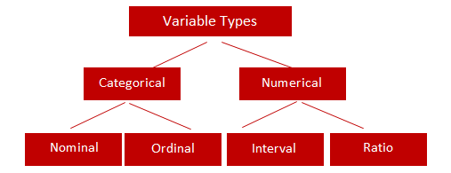
Types of Variables

Slide 3
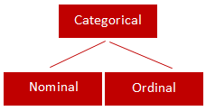
Categorical
Qualitative data are often termed categorical data.
Data that can be added into categories according to their characteristics.
Examples are gender, social class and blood types

Slide 4
Nominal Variable (Unordered list)
A variable that has two or more categories, without any implied ordering.
Examples : Gender - Male, Female
Marital Status - Unmarried, Married, Divorcee
State - New Delhi, Haryana, Illinois, Michigan

Slide 5
Ordinal Variable (Ordered list)
A variable that has two or more categories, with clear ordering. Examples :
Scale - Strongly Disagree, Disagree, Neutral, Agree, Strongly Agree
Rating - Very low, Low, Medium, Great, Very great

Slide 6
Interval
An interval variable is similar to an ordinal variable, except that the intervals between the values of the interval variable are equally spaced.
In other words, it has order and equal intervals.
Examples :
Temperature in Celsius - Temperature of 30°C is higher than 20°C, and temperature of 20°C is higher than 10°C. The size of these intervals is the same.
Annual Income in Dollars - Three people who make $5,000, $10,000 and $15,000. The second person makes $5,000 more than the first person and $5,000 less than the third person, and the size of these intervals is the same.

Slide 7
Ratio
It is interval data with a natural zero point.
When the variable equals 0.0, there is none of that variable. Examples :
Height
Weight
Temperature in Kelvin - It is a ratio variable, as 0.0 Kelvin really does mean 'no temperature.

Slide 8
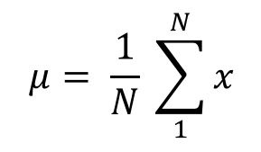
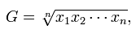
Central Location
(a) Arithmetic Mean
Of these “averages,” the most common and familiar is the arithmetic mean, defined by
(b) Geometric Mean
The geometric mean is defined as the nth root of the product of n observations:

Slide 9
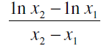
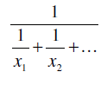
Central Location
© Logarithmic Mean
The logarithmic mean of two numbers is given by the difference of the natural logarithms of the two numbers, divided by the difference between the numbers.
It is used particularly in heat transfer and mass transfer.
(d) Harmonic Mean
The harmonic mean involves inverses—i.e., one divided by each of the quantities.
The harmonic mean is the inverse of the arithmetic mean of all the inverses.

Slide 10
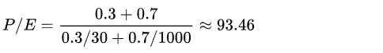
Harmonic Mean
Using the weighted harmonic mean (correct):
price–earnings ratio (P/E),

Slide 11
Median
If all the items with which we are concerned are sorted in order of increasing magnitude (size), from the smallest to the largest, then the median is the middle item.
Consider the five items: 12, 13, 21, 27, 31. Then 21 is the median.
If the number of items is even, the median is given by the arithmetic mean of the two middle items. Consider the six items: 12, 13, 21, 27, 31, 33.
The median is (21 + 27) / 2 = 24.

Slide 12
Mode
If the frequency varies from one item to another, the mode is the value which appears most frequently.
In the case of continuous variables the frequency depends upon how many digits are quoted, so the mode is more usefully considered as the midpoint of the class with the largest frequency.

Slide 13
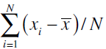
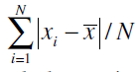
Variability or Spread of the Data
Mean Deviation from the Mean
The mean deviation from the mean, defined as –
Mean Absolute Deviation from the Mean

Slide 14
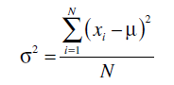
Variability or Spread of the Data
Variance
Since squares of both positive and negative real numbers are always positive, the variance is always positive.

Slide 15
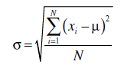
Variability or Spread of the Data
Standard Deviation

Slide 16
Multi Dimensional Array
Create a multidimensional array as follows:
In: m = array([arange(2), arange(2)])
In: m
Out:
array([[0, 1],
[0, 1]])
Show the array shape as follows:
In: m.shape
Out: (2, 2)

Slide 17
NumPy numerical types

Slide 18
NumPy numerical types

Slide 19
NumPy numerical types

Slide 20
Manipulating array shapes
Flattening is transforming a multidimensional array into a one-dimensional array.

Slide 21
Quartiles, Deciles, Percentiles, and Quantiles
Quartiles, deciles, and percentiles divide a frequency distribution into a number of parts containing equal frequencies.
Quartiles divide the range of values into four parts, each containing one quarter of the values.
Percentiles divide into a hundred parts, each containing one hundredth of the total frequency.
Quantile divides a frequency distribution into parts containing stated proportions of a distribution.

Slide 22
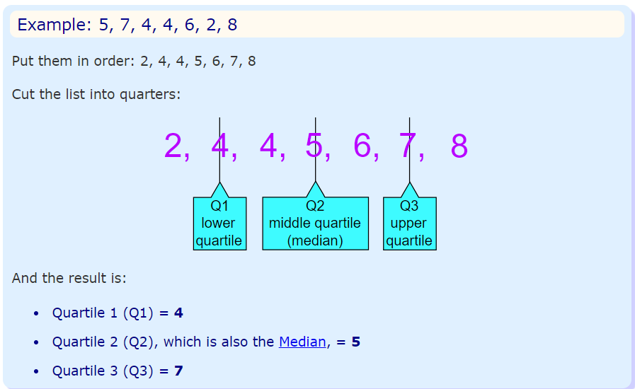
Quartiles
Quartiles are the values that divide a list of numbers into quarters:
Put the list of numbers in order
Then cut the list into four equal parts
The Quartiles are at the "cuts“

Slide 23
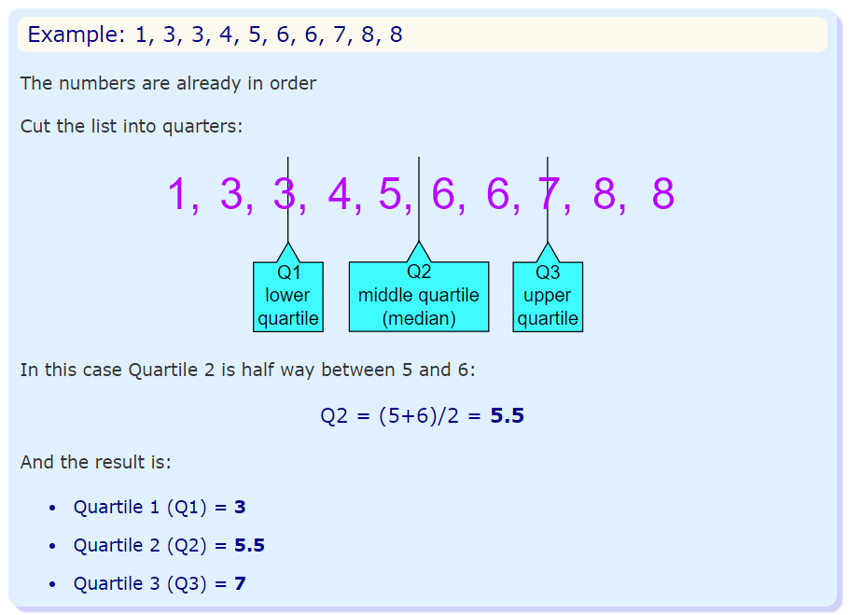
Quartiles

Slide 24
Decile
What is a Decile used for in Real Life?
Deciles and decile ranks are used more often in real life than in the classroom. For example, Australia uses decile ranks to report drought data. Deciles 1-2 represent the lowest 20% (“much below normal”). That means droughts that are “much below normal” don’t occur more than 20% of the time.
Deciles are also commonly used for college admissions and high school rankings. For example, this chart from Roanoke College shows the high school decile rankings for the student body.

Slide 25
Decile
Decile Rank | Percentile
1 | 10th
2 | 20th
3 | 30th
4 | 40th
5 | 50th
6 | 60th
7 | 70th
8 | 80th
9 | 90th

Slide 26
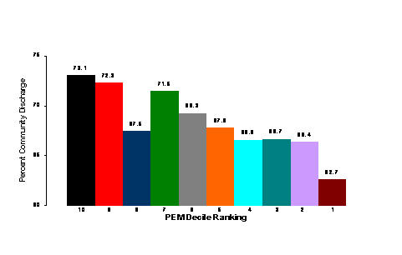
Decile

Slide 27
Normal Distribution
A normal distribution, sometimes called the bell curve, is a distribution that occurs naturally in many situations.
For example, the bell curve is seen in tests like the SAT and GRE.
The bulk of students will score the average (C), while smaller numbers of students will score a B or D.
An even smaller percentage of students score an F or an A.
This creates a distribution that resembles a bell (hence the nickname).
The bell curve is symmetrical. Half of the data will fall to the left of the mean; half will fall to the right.

Slide 28
Normal Distribution
Many groups follow this type of pattern. That’s why it’s widely used in business, statistics and in government bodies like the FDA:
Heights of people.
Measurement errors.
Blood pressure.
Points on a test.
IQ scores.
Salaries.

Slide 29
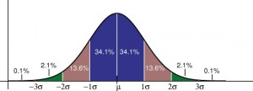
Normal Distribution
The empirical rule tells you what percentage of your data falls within a certain number of standard deviations from the mean: • 68% of the data falls within one standard deviation of the mean. • 95% of the data falls within two standard deviations of the mean. • 99.7% of the data falls within three standard deviations of the mean.

Slide 30
Normal Distribution
The standard deviation controls the spread of the distribution.
A smaller standard deviation indicates that the data is tightly clustered around the mean; the normal distribution will be taller.
A larger standard deviation indicates that the data is spread out around the mean; the normal distribution will be flatter and wider.

Slide 31
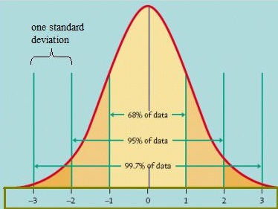
Standard Normal Model

Slide 32
Normal Distribution
Properties of a normal distribution
The mean, mode and median are all equal.
The curve is symmetric at the center (i.e. around the mean, μ).
Exactly half of the values are to the left of center and exactly half the values are to the right.
The total area under the curve is 1.

Slide 33
Word problems with normal distribution: “Between”: Steps
Step 1: Identify the parts of the word problem. The word problem will identify:
The mean (average or μ).
Standard deviation (σ).
Number selected (i.e. “choose one at random” or “select ten at random”).
X: the numbers associated with “between” (i.e. “between $5,000 and $10,000” would have X as 5,000 and as $10,000).

Slide 34
Word problems with normal distribution: “Between”: Steps
Step 1: Identify the parts of the word problem. The word problem will identify:
The mean (average or μ).
Standard deviation (σ).
Number selected (i.e. “choose one at random” or “select ten at random”).
X: the numbers associated with “between” (i.e. “between $5,000 and $10,000” would have X as 5,000 and as $10,000).

Slide 35
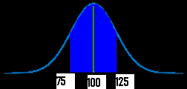
Word problems with normal distribution: “Between”: Steps
Step 2: Draw a graph. Put the mean you identified in Step 1 in the center.
Put the number associated with “between” on the graph (take a guess at where the numbers would fall–it doesn’t have to be exact).
For example, if your mean was $100, and you were asked for “hourly wages between $75 and $125”) your graph will look something like this:

Slide 36
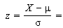
Word problems with normal distribution: “Between”: Steps
Step 3:Figure out the z-scores.
Plug the first X value (in my graph above, it’s 75) into the z value formula and solve. The μ (the mean), is 100 from the sample graph. You can get these figures (including σ, the standard deviation) from your answers in step 1 :
z score formula
*Note: if the formula confuses you, all this formula is asking you to do is:
subtract the mean from X
divide by the standard deviation.

Slide 37
Word problems with normal distribution: “Between”: Steps
Step 4: Repeat step 3 for the second X.
Step 5: Take the numbers from step 3 and 4 and use them to find the area in the z-table.
Step 6a:
Convert the answer from step 5 into a percentage.
For example, 0.1293 is 12.93%.
That’s it–skip step 6b!
Step 6b
Multiply the sample size (found in step 1) by the z-value you found in step 4. For example, 0.300 * 100 = 30.
That’s it!

Slide 38
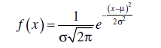
Normal Distribution
They are approximately symmetrical, and the mode is close to the centre of the distribution.
The mean, median, and mode are close together.
The shape of the distribution can be approximated by a bell: nearly flat on top, then decreasing more quickly, then decreasing more slowly toward the tails of the distribution.
This implies that values close to the mean are relatively frequent, and values farther from the mean tend to occur less frequently.
Probability Density Function

Slide 39
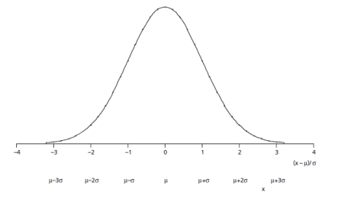
Normal Distribution

Slide 40
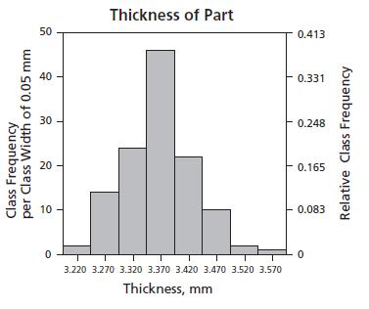
Normal Distribution

Slide 41
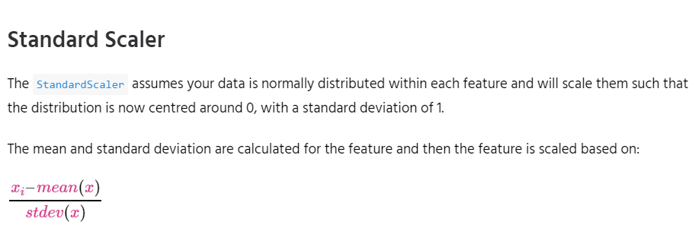
Feature Scaling
StandardScaler
MinMaxScaler
RobustScaler
Normalizer

Slide 42
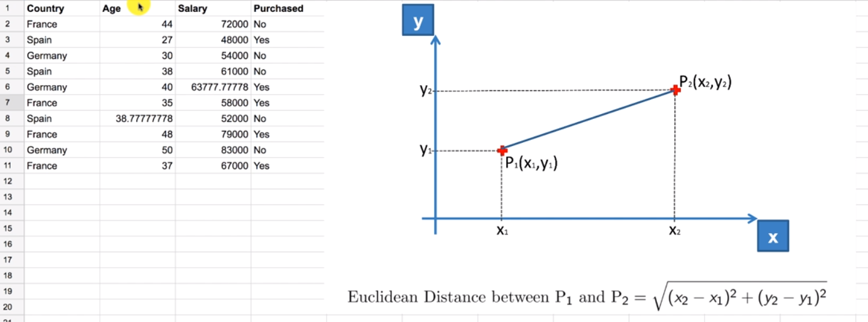

Slide 43
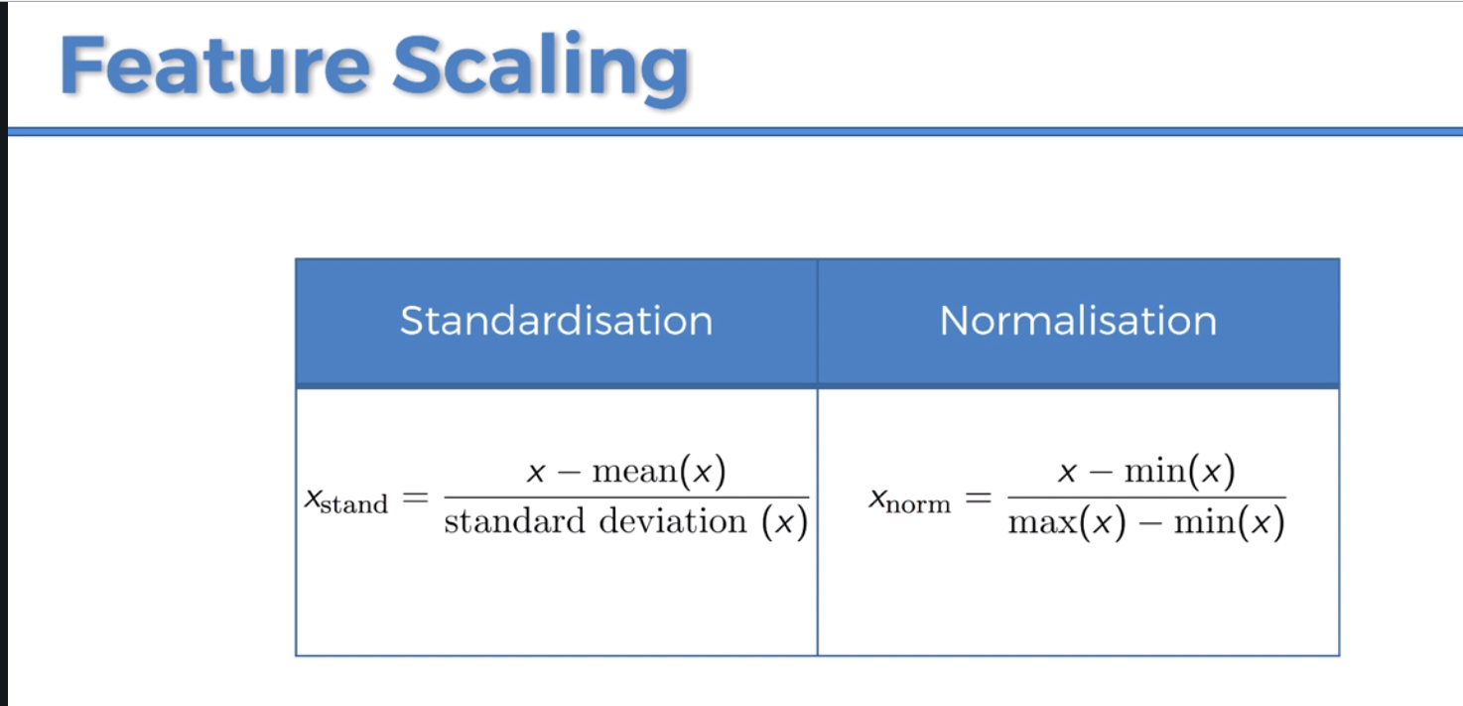

Slide 44
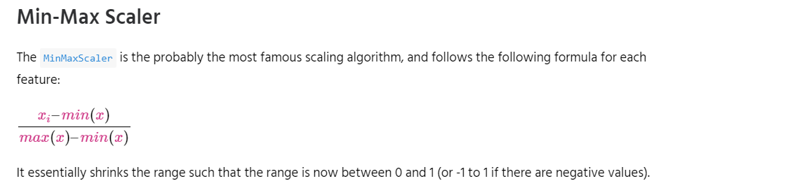
Feature Scaling
StandardScaler
MinMaxScaler
RobustScaler
Normalizer

Slide 45
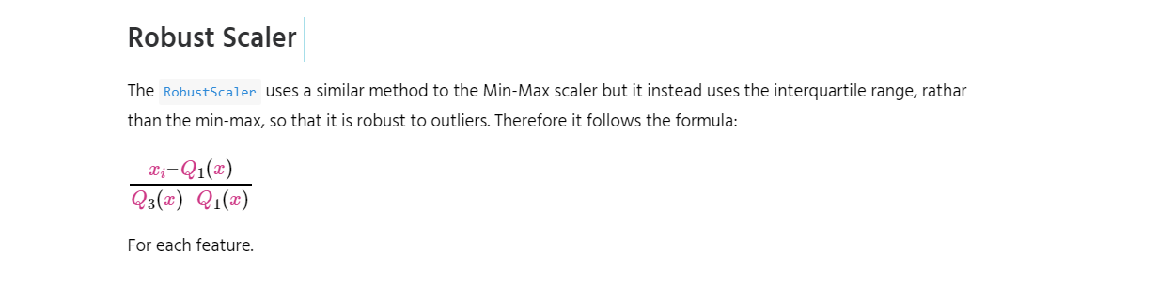
Feature Scaling

Slide 46
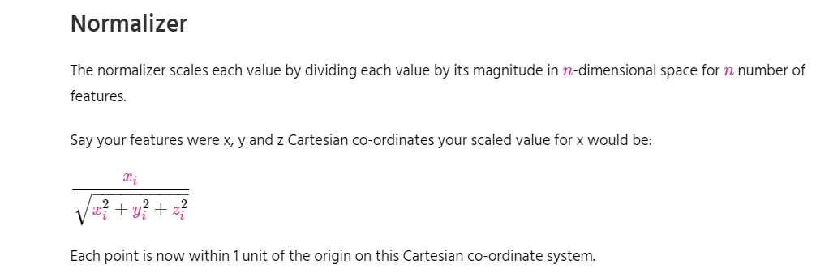
Feature Scaling

Slide 47
Simple Linear Regression
Simple linear regression is a statistical method that allows us to summarize and study relationships between two continuous (quantitative) variables:
One variable, denoted x, is regarded as the predictor, explanatory, or independent variable.
The other variable, denoted y, is regarded as the response, outcome, or dependent variable.

Slide 48
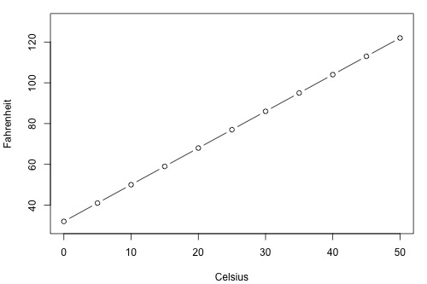
Simple Linear Regression

Slide 49
Types of Relationships
Deterministic
Temperature conversion
Circumference = π × diameter
Hooke's Law: Y = α + βX, where Y = amount of stretch in a spring, and X = applied weight.
Ohm's Law: I = V/r, where V = voltage applied, r = resistance, and I = current.
Boyle's Law: For a constant temperature, P = α/V, where P = pressure, α = constant for each gas, and V = volume of gas.

Slide 50
Types of Relationships
Statistical
Height and weight — as height increases, you'd expect weight to increase, but not perfectly.
Alcohol consumed and blood alcohol content — as alcohol consumption increases, you'd expect one's blood alcohol content to increase, but not perfectly.
Vital lung capacity and pack-years of smoking — as amount of smoking increases (as quantified by the number of pack-years of smoking), you'd expect lung function (as quantified by vital lung capacity) to decrease, but not perfectly.
Driving speed and gas mileage — as driving speed increases, you'd expect gas mileage to decrease, but not perfectly.

Slide 51
Real Time Example
We have a dataset which contains information about relationship between ‘number of hours studied’ and ‘marks obtained’.
Many students have been observed and their hours of study and grade are recorded.
This will be our training data. Goal is to design a model that can predict marks if given the number of hours studied.
Using the training data, a regression line is obtained which will give minimum error.
This linear equation is then used for any new data.
That is, if we give number of hours studied by a student as an input, our model should predict their mark with minimum error.

Slide 52
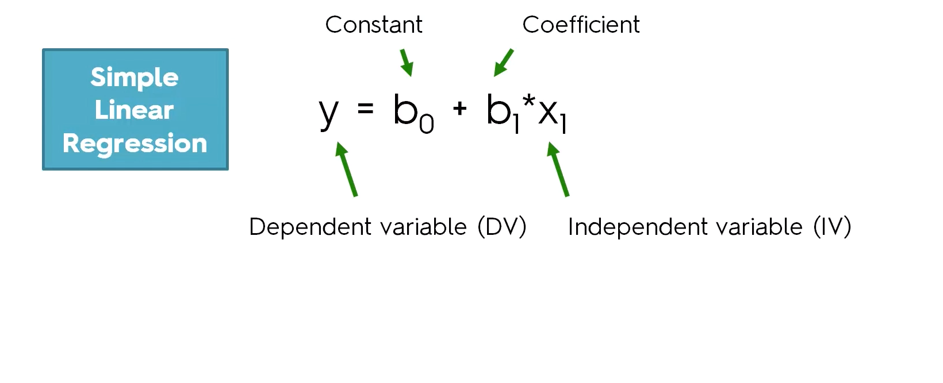

Slide 53
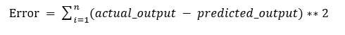
Simple Linear Regression
The values b0 and b1 must be chosen so that they minimize the error.
If sum of squared error is taken as a metric to evaluate the model, then goal to obtain a line that best reduces the error.
If we don’t square the error, then positive and negative point will cancel out each other.

Slide 54
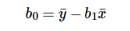
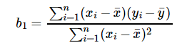
Simple Linear Regression
For model with one predictor,

Slide 55
Simple Linear Regression
Exploring ‘b1’
If b1 > 0, then x(predictor) and y(target) have a positive relationship. That is increase in x will increase y.
If b1 < 0, then x(predictor) and y(target) have a negative relationship. That is increase in x will decrease y.

Slide 56
Simple Linear Regression
Exploring ‘b0’
If the model does not include x=0, then the prediction will become meaningless with only b0. For example, we have a dataset that relates height(x) and weight(y). Taking x=0(that is height as 0), will make equation have only b0 value which is completely meaningless as in real-time height and weight can never be zero. This resulted due to considering the model values beyond its scope.
If the model includes value 0, then ‘b0’ will be the average of all predicted values when x=0. But, setting zero for all the predictor variables is often impossible.
The value of b0 guarantee that residual have mean zero. If there is no ‘b0’ term, then regression will be forced to pass over the origin. Both the regression co-efficient and prediction will be biased.

Slide 57
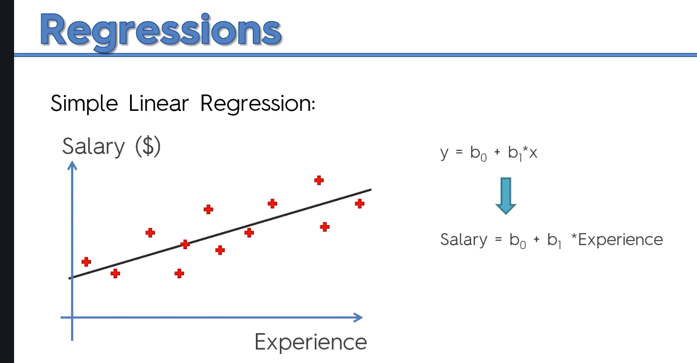

Slide 58
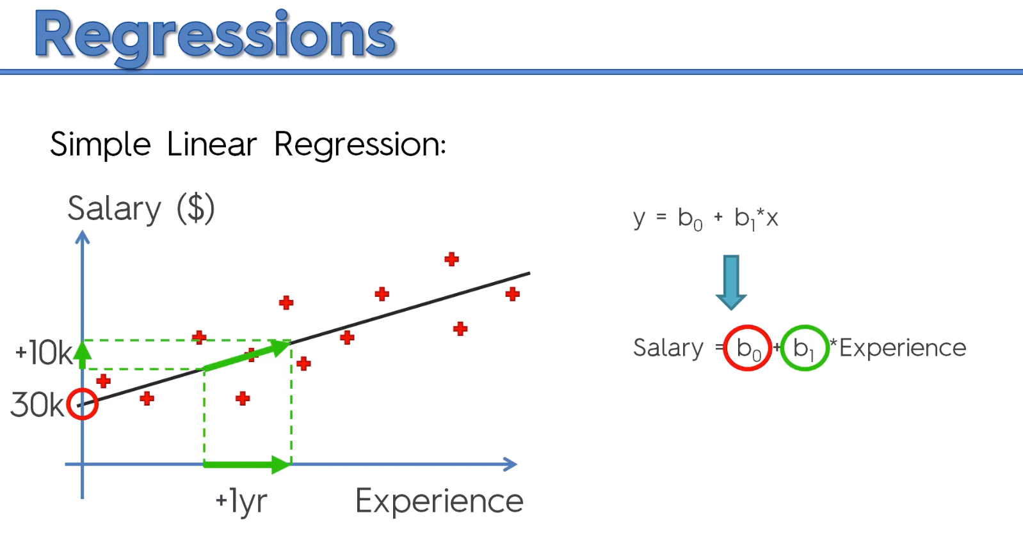

Slide 59
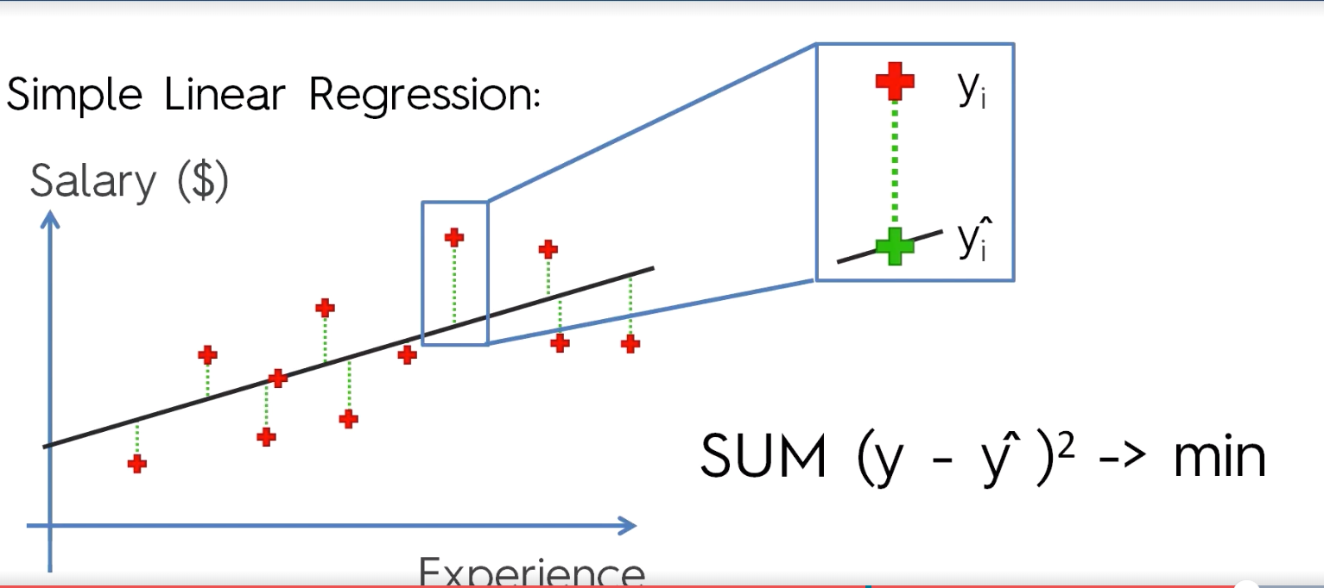
Ordinary Least Square Method

Slide 60
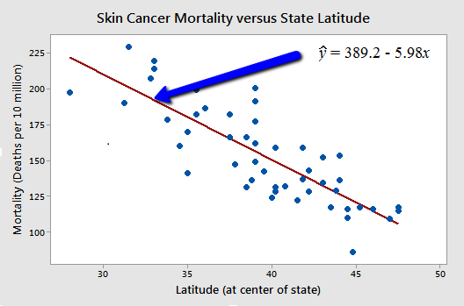
Types of Relationships

Slide 61
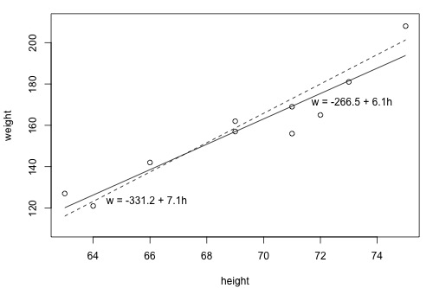
What is the "Best Fitting Line"?

Slide 62
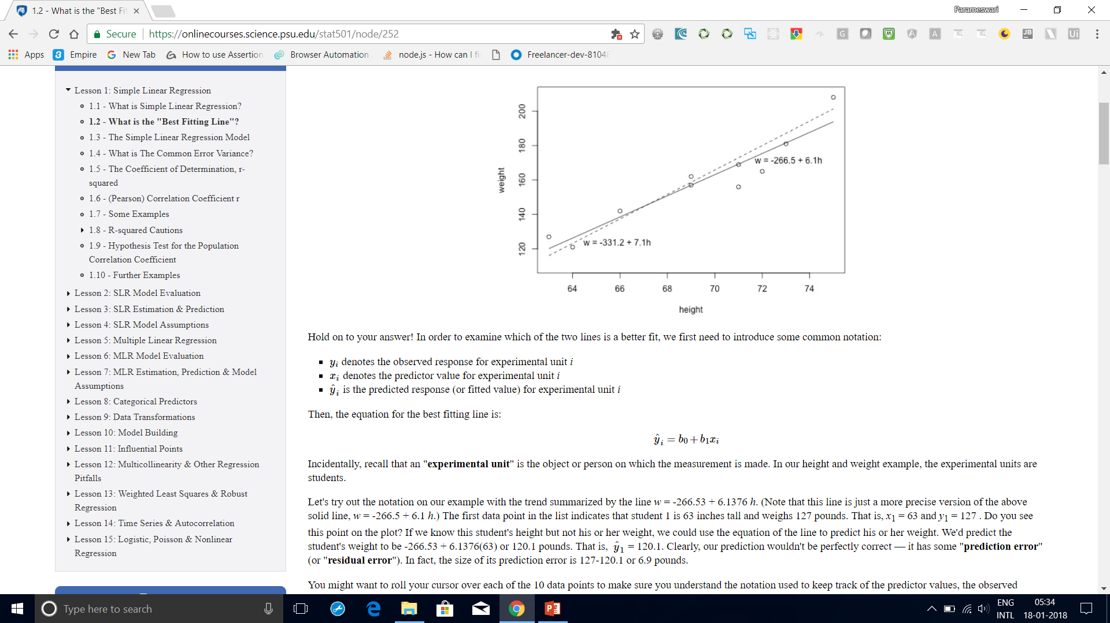
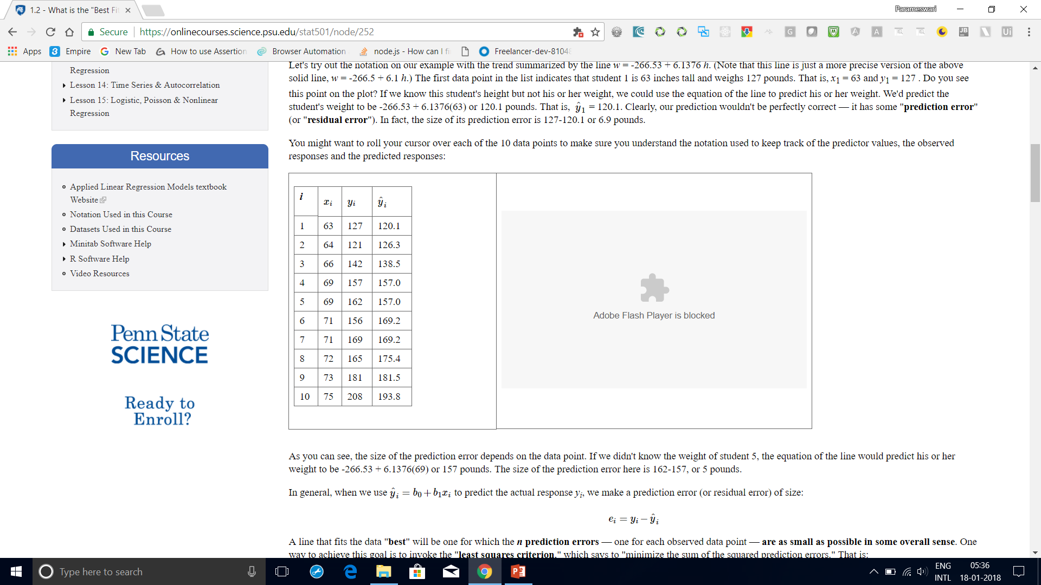
What is the "Best Fitting Line"?
it has some "prediction error" (or "residual error").
In fact, the size of its prediction error is 127-120.1 or 6.9 pounds.
As you can see, the size of the prediction error depends on the data point.
If we didn't know the weight of student 5, the equation of the line would predict his or
her weight to be -266.53 + 6.1376(69) or 157 pounds.
The size of the prediction error here is 162-157, or 5 pounds.

Slide 63
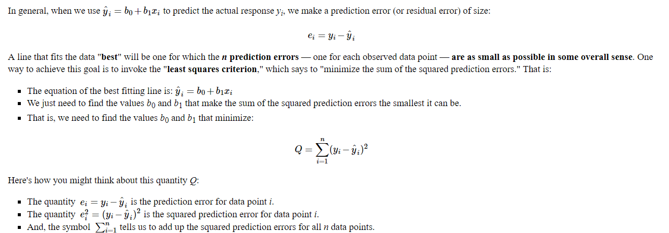
What is the "Best Fitting Line"?

Slide 64
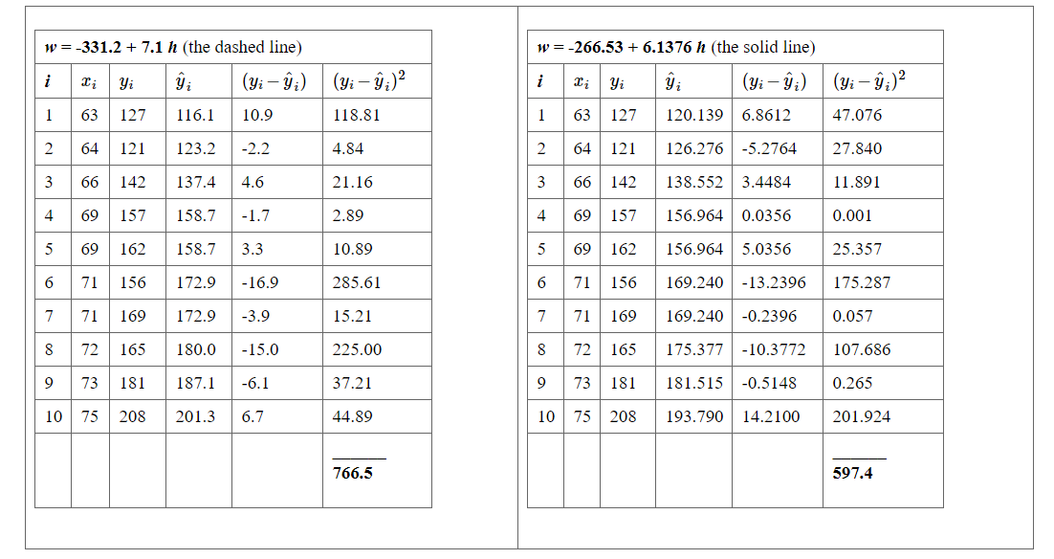
What is the "Best Fitting Line"?

Slide 65
What is the "Best Fitting Line"?
Based on the least squares criterion, which equation best summarizes the data?
The sum of the squared prediction errors is 766.5 for the dashed line, while it is only 597.4 for the solid line.
Therefore, of the two lines, the solid line, w = -266.53 + 6.1376h, best summarizes the data.

Slide 66
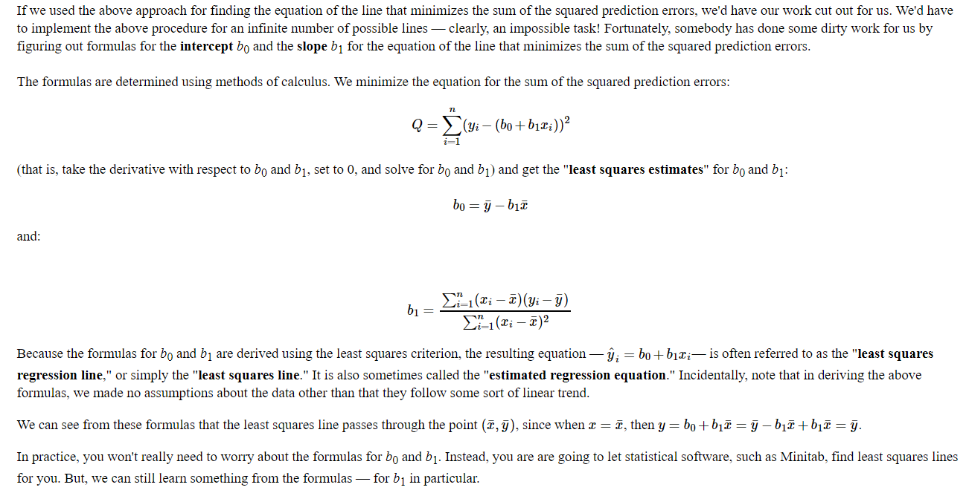
What is the "Best Fitting Line"?

Slide 67
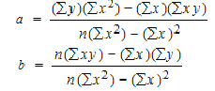
Slope and Intercept calculation

Slide 68
How to Find a Linear Regression Equation: Steps
Step 1: Make a chart of your data, filling in the columns in the same way as you would fill in the chart if you were finding the Pearson’s Correlation Coefficient.
SUBJECT | AGE X | GLUCOSE LEVEL Y | XY | X² | Y²
1 | 43 | 99 | 4257 | 1849 | 9801
2 | 21 | 65 | 1365 | 441 | 4225
3 | 25 | 79 | 1975 | 625 | 6241
4 | 42 | 75 | 3150 | 1764 | 5625
5 | 57 | 87 | 4959 | 3249 | 7569
6 | 59 | 81 | 4779 | 3481 | 6561
Σ | 247 | 486 | 20485 | 11409 | 40022
From the above table, Σx = 247, Σy = 486, Σxy = 20485, Σx2 = 11409, Σy2 = 40022. n is the sample size (6, in our case).

Slide 69
How to Find a Linear Regression Equation: Steps
Step 2: Use the following equations to find a and b.
a = 65.1416 b = .385225

Slide 70
How to Find a Linear Regression Equation: Steps
Step 2: Use the following equations to find a and b.
Find a:
((486 × 11,409) – ((247 × 20,485)) / 6 (11,409) – 247²)
484979 / 7445
=65.14
Find b:
(6(20,485) – (247 × 486)) / (6 (11409) – 247²)
(122,910 – 120,042) / 68,454 – 247²
2,868 / 7,445
= .385225

Slide 71
How to Find a Linear Regression Equation: Steps
Step 3: Insert the values into the equation. y’ = a + bx y’ = 65.14 + .385225x
That’s how to find a linear regression equation by hand!

Slide 72
Interpolation vs Regression
In the mathematical field of numerical analysis, interpolation is a method of constructing new data points within the range of a discrete set of known data points.
Interpolation is the process of deriving a simple function from a set of discrete data points so that the function passes through all the given data points (i.e. reproduces the data points exactly) and can be used to estimate data points in-between the given ones.
Newton method

Slide 73
Interpolation vs Regression
Regression is different from interpolation in that it allows us to approximate overdetermined system, which has more equations than unknowns.
This is useful when the exact solution is too expensive or unnecessary due to errors in the data, such as measurement errors or random noise.

Slide 74
Interpolation vs Regression
In interpolation you are given some data points, and you are supposed to find a curve which fits the input/output relationship perfectly. In case of interpolation, you don't have to worry about variance of the fitted curve. As long as your curve is giving perfect output(for a given dataset), you are done.
In regression, your curve should not be over-fitting. It should give you a regularized model so that you can predict future values. Variance of your function should be as low as possible. Your model should be generalized so that you can accurately predict future values.

Slide 75
Interpolation vs Regression
Interpolation is like an algorithm without a "brain": it tries to achieve perfect match to the given data
Regression is the same algorithm with the power to generalize. It won't fit perfectly to your data but at least it will try to learn some insights from it.

Slide 80
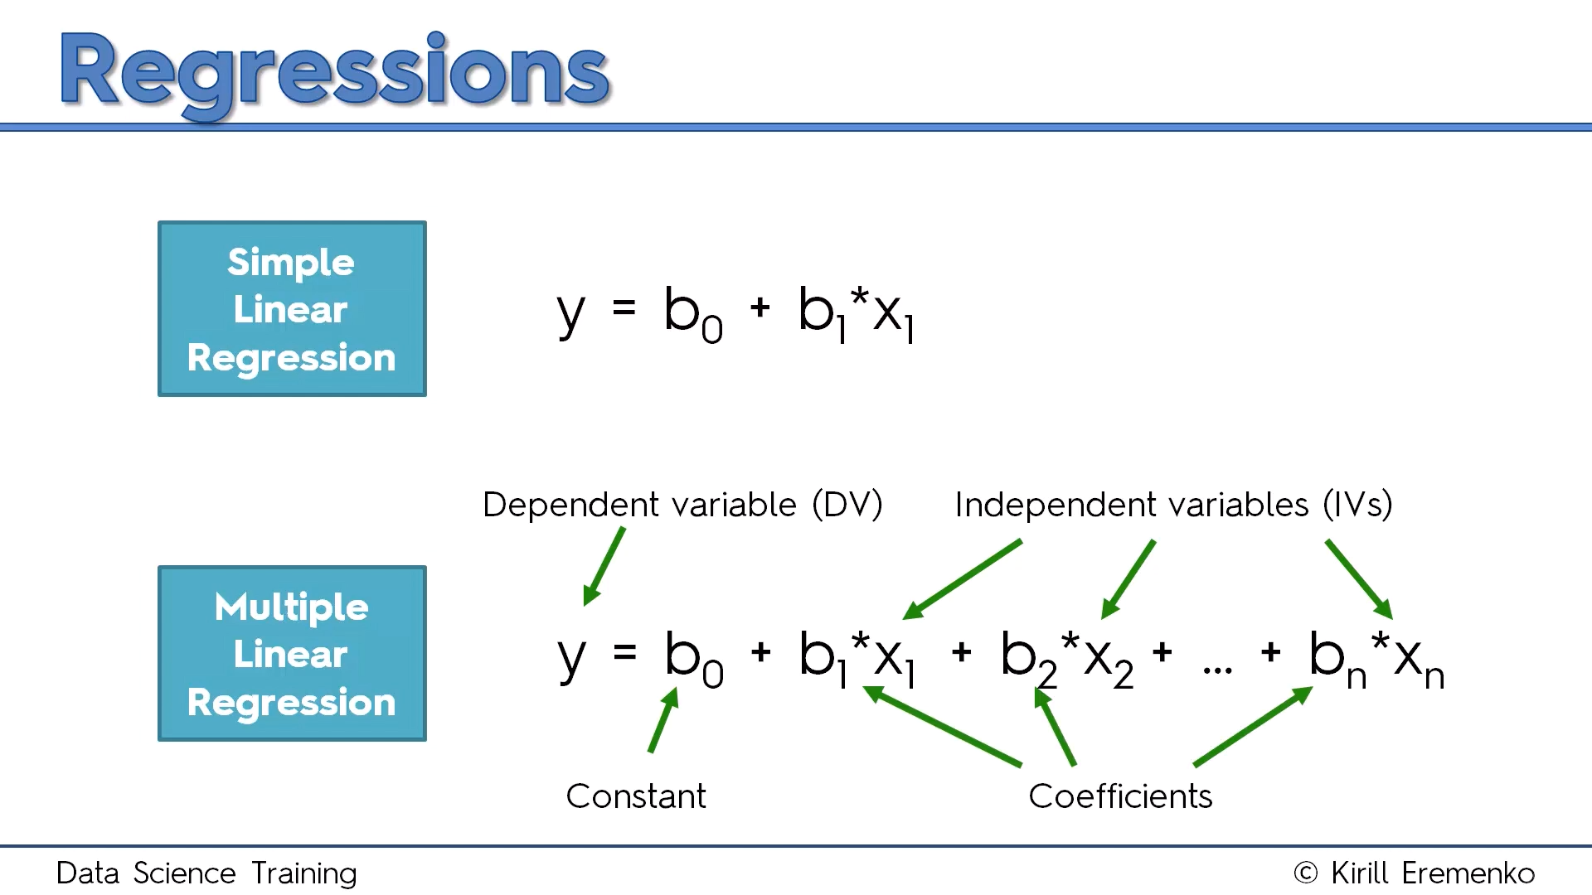
Multiple Linear Regression

Slide 81
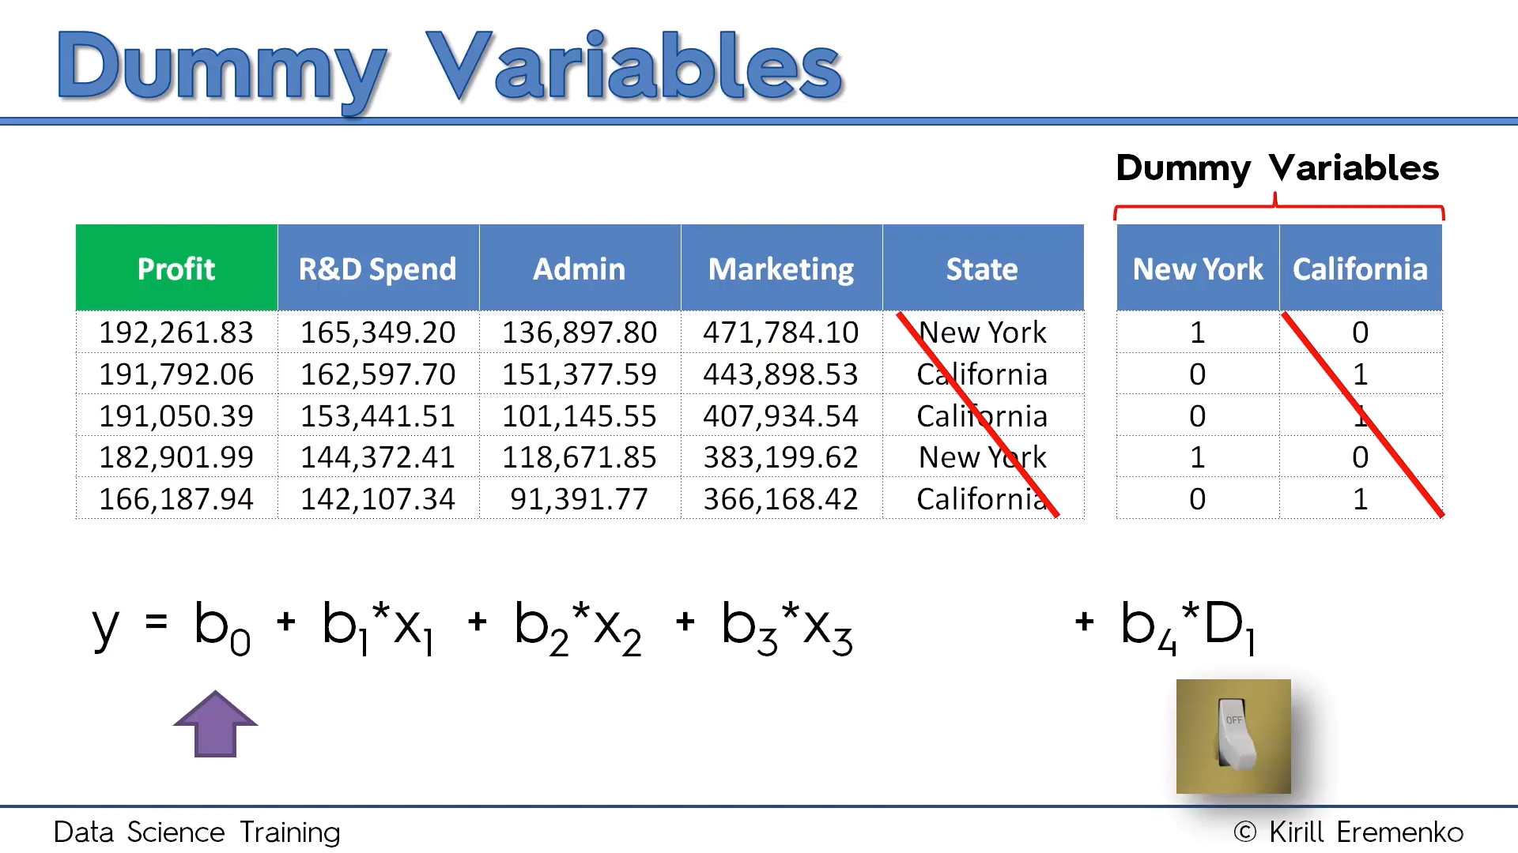

Slide 82
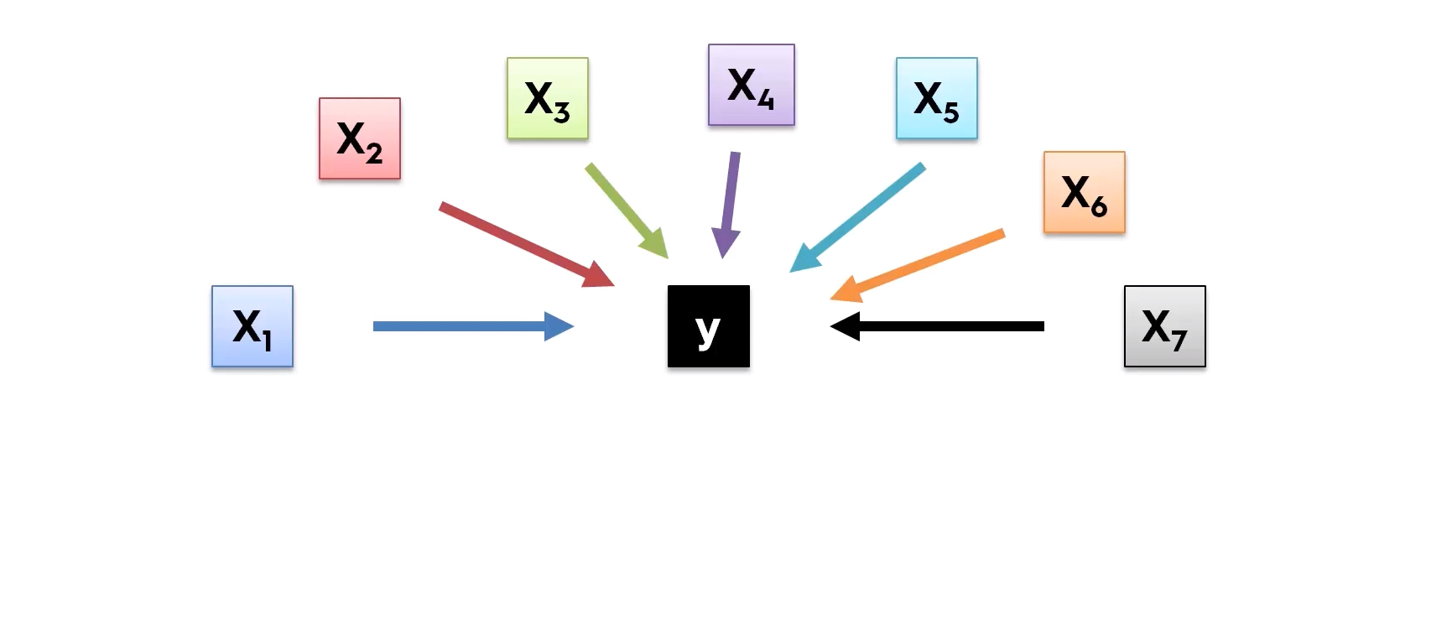
Building Model

Slide 83
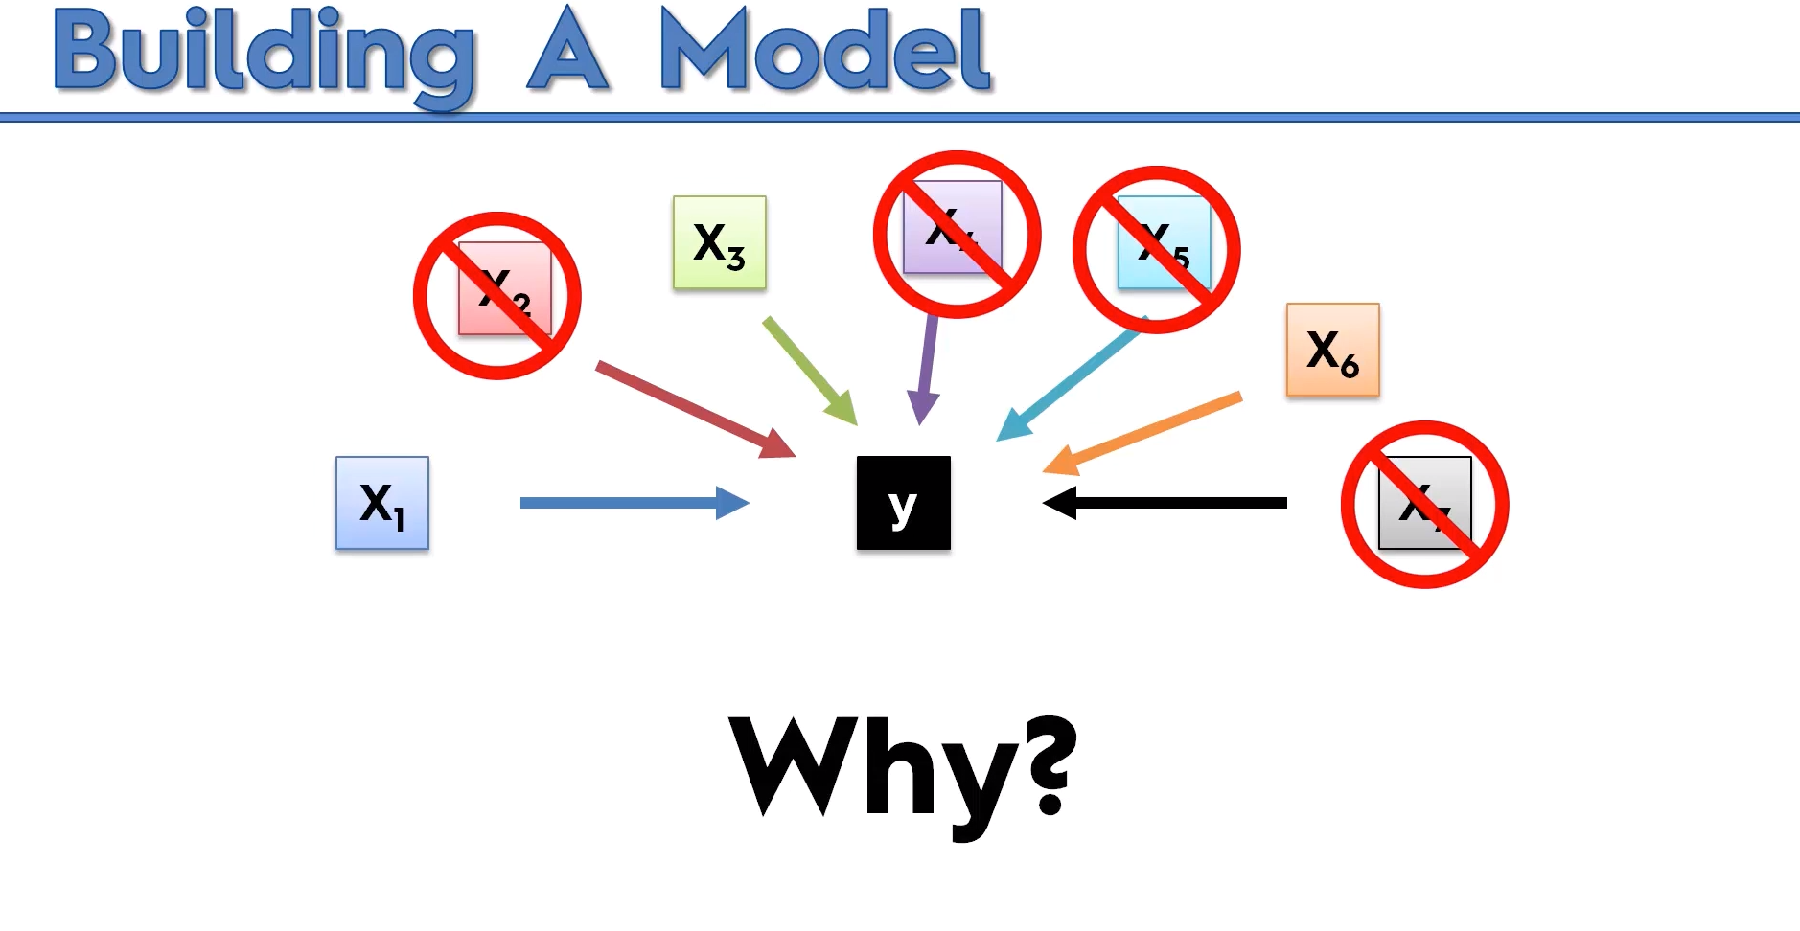

Slide 84
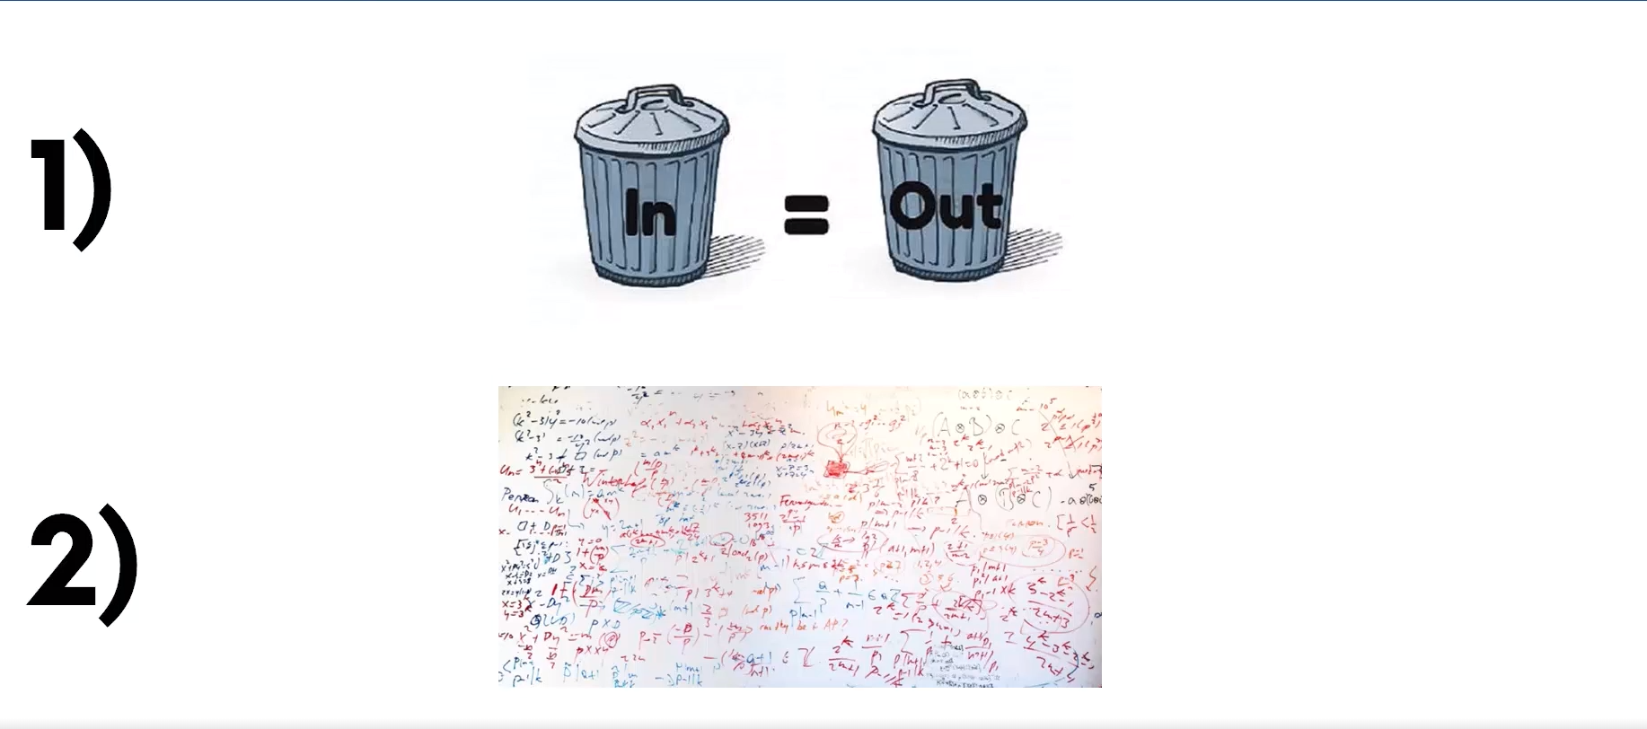

Slide 85
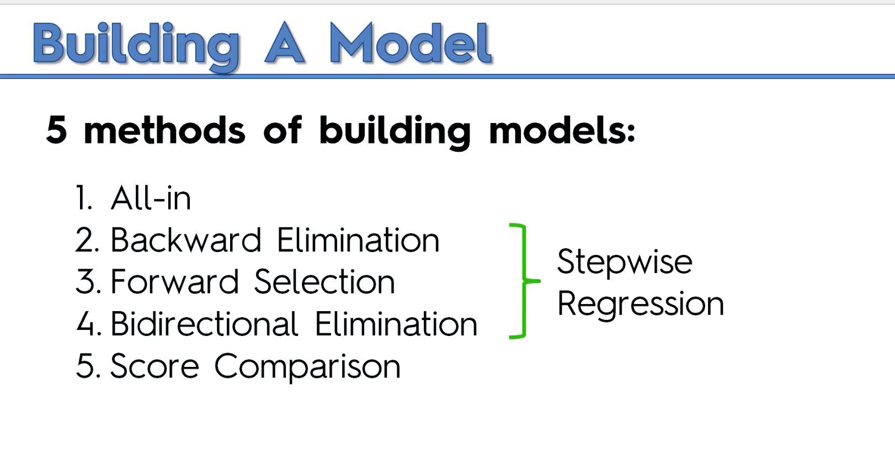

Slide 86
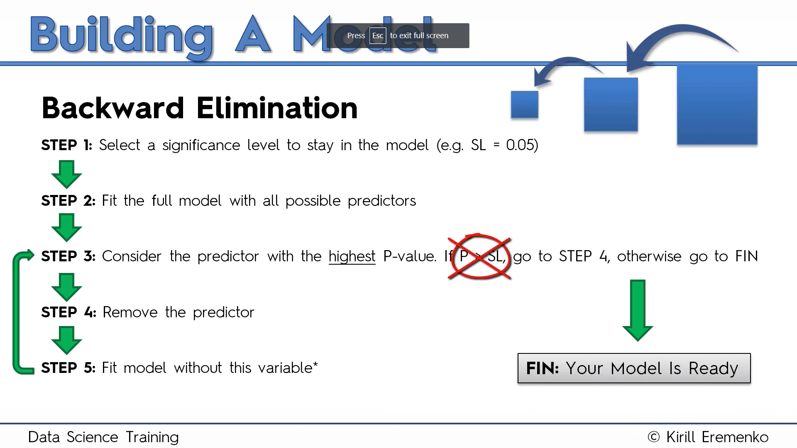

Slide 87


Slide 88


Slide 89


Slide 90


Slide 91
import statsmodels.formula.api as sm
def backwardElimination(x, sl):
numVars = len(x[0])
for i in range(0, numVars):
regressor_OLS = sm.OLS(y, x).fit()
maxVar = max(regressor_OLS.pvalues).astype(float)
if maxVar > sl:
for j in range(0, numVars - i):
if (regressor_OLS.pvalues[j].astype(float) == maxVar):
x = np.delete(x, j, 1)
regressor_OLS.summary()
return x
SL = 0.05
X_opt = X[:, [0, 1, 2, 3, 4, 5]]
X_Modeled = backwardElimination(X_opt, SL)

Slide 92


Slide 93


Slide 94


Slide 95


Slide 96


Slide 97


Slide 98


Slide 99

Ordinary Least Square Method

Slide 100

We can drop few variables and select only those that have p values < 0.5 and then we can check improvement in the model.
A general approach to compare two different models is AIC( Akaike Information Criteria) and the model with minimum AIC is the best one.

Slide 101


Slide 102


Slide 103
Support Vector Regression
SVM is a supervised learning model
Problem:
I have a business and I receive a lot of emails from customers every day. Some of these emails are complaints and should be answered very quickly. I would like a way to identify them quickly so that I answer these email in priority.

Slide 104
Support Vector Regression
Approach: I can use a supervised machine learning algorithm.
Step 1: I need a lot of emails, the more the better. Step 2: I will read the title of each email and classify it by saying "it is a complaint" or "it is not a complaint". It put a label on each email. Step 3: I will train a model on this dataset Step 4: I will assess the quality of the prediction (using cross validation) Step 5: I will use this model to predict if an email is a complaint or not.
In this case, if I have trained the model with a lot of emails then it will perform well. SVM is just one among many models you can use to learn from this data and make predictions.

Slide 105
Support Vector Regression
SVMs - Support Vector Machines
Wikipedia tells us that SVMs can be used to do two things: classification or regression.
SVM is used for classification
SVR (Support Vector Regression) is used for regression

Slide 106
What is the goal of the Support Vector Machine (SVM)?
The goal of a support vector machine is to find the optimal separating hyperplane which maximizes the margin of the training data.
The first thing we can see from this definition, is that a SVM needs training data. Which means it is a supervised learning algorithm.
It is also important to know that SVM is a classification algorithm. Which means we will use it to predict if something belongs to a particular class.

Slide 107


Slide 108
SVM
We have plotted the size and weight of several people, and there is also a way to distinguish between men and women.
With such data, using a SVM will allow us to answer the following question:
Given a particular data point (weight and size), is the person a man or a woman ?
For instance: if someone measures 175 cm and weights 80 kg, is it a man of a woman?

Slide 109

What is a separating hyperplane?
For instance, we could trace a line and then all the data points representing men will be above the line, and all the data points representing women will be below the line.
Such a line is called a separating hyperplane and is depicted below:

Slide 110
If it is just a line, why do we call it an hyperplane ?
An hyperplane is a generalization of a plane.
in one dimension, an hyperplane is called a point
in two dimensions, it is a line
in three dimensions, it is a plane
in more dimensions you can call it an hyperplane

Slide 111

What is the optimal separating hyperplane?
The fact that you can find a separating hyperplane, does not mean it is the best one !
In the example below there is several separating hyperplanes. Each of them is valid as it successfully separates our data set with men on one side and women on the other side.

Slide 112

Optimal Hyperplane
The black hyperplane classifies more accurately than the green one

Slide 113

What is the margin and how does it help choosing the optimal hyperplane?
Given a particular hyperplane, we can compute the distance between the hyperplane and the closest data point.
Once we have this value, if we double it we will get what is called the margin.
Basically the margin is a no man's land. There will never be any data point inside the margin.

Slide 114
Optimal Hyperplane
We can make the following observations:
If an hyperplane is very close to a data point, its margin will be small.
The further an hyperplane is from a data point, the larger its margin will be.
This means that the optimal hyperplane will be the one with the biggest margin.

Slide 115

Data Points

Slide 116

Linear Fit

Slide 117
Linear Fit
rmse <- function(error)
{
sqrt(mean(error^2))
}
error <- model$residuals # same as data$Y - predictedY
predictionRMSE <- rmse(error) # 5.703778
How to Improve?

Slide 118

SVM Regression
# /!\ this time svrModel$residuals is not the same as data$Y - predictedY
# so we compute the error like this
error <- data$Y - predictedY
svrPredictionRMSE <- rmse(error) # 3.157061

Slide 119

Improved SVM with eps factor adjustment

Slide 120


What is a vector?
A vector is an object that has both a magnitude and a direction.
If we define a point A(3,4) in R2 we can plot it like this.
Definition: Any point x=(x1,x2),x≠0, in R2 specifies a vector in the plane, namely the vector starting at the origin and ending at x.
If we say that the point at the origin is the point O(0,0) then the vector above is the vector OA→. We could also give it an arbitrary name such as u.

Slide 121


The magnitude
The magnitude or length of a vector x is written ∥x∥ and is called its norm.
For our vector OA→, ∥OA∥ is the length of the segment OA

Slide 122

The direction
The direction is the second component of a vector.
Definition : The direction of a vector u(u1,u2) is the vector w(u1∥u∥,u2∥u∥)

Slide 123


Computing the direction vector
The direction of u(3,4) is the vector w(0.6,0.8)

Slide 124

The sum of two vectors

Slide 125

Third Vector

Slide 126

The difference between two vectors

Slide 127

The difference between two vectors

Slide 128

The dot product
Definition: Geometrically, it is the product of the Euclidian magnitudes of the two vectors and the cosine of the angle between them

Slide 129

We can see that
θ=β−α
So computing cos(θ) is like computing cos(β−α)
There is a special formula called the difference identity for cosine which says that:
cos(β−α)=cos(β)cos(α)+sin(β)sin(α)

Slide 130


Slide 131


Slide 132

The SVM hyperplane
Understanding the equation of the hyperplane
You probably learnt that an equation of a line is : y=ax+b. However when reading about hyperplane, you will often find that the equation of an hyperplane is defined by :

Slide 133
The SVM hyperplane
How does these two forms relate ?
In the hyperplane equation you can see that the name of the variables are in bold. Which means that they are vectors !
Moreover, wTx is how we compute the inner product of two vectors, and if you recall, the inner product is just another name for the dot product !

Slide 134

The SVM hyperplane

Slide 135

The SVM hyperplane
For two reasons:
it is easier to work in more than two dimensions with this notation,
the vector w will always be normal to the hyperplane.

Slide 136
SVM hyperplane
Our goal is to find the distance between the point A(3,4) and the hyperplane.
We start with two vectors, w=(2,1) which is normal to the hyperplane, and a=(3,4) which is the vector between the origin and A.

Slide 137


Slide 138

SVM Hyperplane
Compute the margin of the hyperplane
Now that we have the distance ∥p∥ between A and the hyperplane, the margin is defined by :

Slide 139

Optimal hyperplane

Slide 140
α
Maximum Margin
x
f
y^{est}
Maximizing the margin is good according to intuition and PAC theory
Implies that only support vectors are important; other training examples are ignorable.
Empirically it works very very well.
f(x,w,b) = sign(w x + b)
denotes +1
denotes -1
The maximum margin linear classifier is the linear classifier with the, um, maximum margin.
This is the simplest kind of SVM (Called an LSVM)
Support Vectors are those datapoints that the margin pushes up against
Linear SVM

Slide 141
Linear SVM Mathematically
x⁺
M=Margin Width
“Predict Class = +1” zone
X⁻
wx+b=1
“Predict Class = -1” zone
wx+b=0
wx+b=-1
What we know:
w . x⁺ + b = +1
w . x⁻ + b = -1
w . (x⁺-x⁻⁾ = 2

Slide 142
Linear SVM Mathematically
Goal: 1) Correctly classify all training data
if y_{i} = +1
if y_{i} = -1
for all i
2) Maximize the Margin
same as minimize
We can formulate a Quadratic Optimization Problem and solve for w and b
Minimize
subject to

Slide 143
Solving the Optimization Problem
Find w and b such that
Φ(w) =½ w^{T}w is minimized;
and for all {(x_{i} ,y_{i})}: y_{i} (w^{T}x_{i} + b) ≥ 1
Need to optimize a quadratic function subject to linear constraints.
Quadratic optimization problems are a well-known class of mathematical programming problems, and many (rather intricate) algorithms exist for solving them.
The solution involves constructing a dual problem where a Lagrange multiplier α_{i} is associated with every constraint in the primary problem:
Find α₁…α_{N} such that
Q(α) =Σα_{i} - ½ΣΣα_{i}α_{j}y_{i}y_{j}x_{i}^{T}x_{j} is maximized and
(1) Σα_{i}y_{i} = 0
(2) α_{i} ≥ 0 for all α_{i}

Slide 144
The Optimization Problem Solution
The solution has the form:
Each non-zero α_{i} indicates that corresponding x_{i} is a support vector.
Then the classifying function will have the form:
Notice that it relies on an inner product between the test point x and the support vectors x_{i} – we will return to this later.
Also keep in mind that solving the optimization problem involved computing the inner products x_{i}^{T}x_{j} between all pairs of training points.
w =Σα_{i}y_{i}x_{i} b= y_{k}- w^{T}x_{k} for any x_{k} such that α_{k}≠ 0
f(x) = Σα_{i}y_{i}x_{i}^{T}x + b

Slide 145
Dataset with noise
denotes +1
denotes -1
Hard Margin: So far we require all data points be classified correctly
- No training error
What if the training set is noisy?
- Solution 1: use very powerful kernels
OVERFITTING!

Slide 146
Soft Margin Classification
Slack variables ξi can be added to allow misclassification of difficult or noisy examples.
What should our quadratic optimization criterion be?
Minimize
ε₁₁
ε₂
wx+b=1
ε₇
wx+b=0
wx+b=-1

Slide 147
Hard Margin v.s. Soft Margin
The old formulation:
The new formulation incorporating slack variables:
Parameter C can be viewed as a way to control overfitting.
Find w and b such that
Φ(w) =½ w^{T}w is minimized and for all {(x_{i} ,y_{i})}
y_{i} (w^{T}x_{i} + b) ≥ 1
Find w and b such that
Φ(w) =½ w^{T}w + CΣξ_{i} is minimized and for all {(x_{i} ,y_{i})}
y_{i} (w^{T}x_{i} + b) ≥ 1- ξ_{i} and ξ_{i} ≥ 0 for all i

Slide 148
Linear SVMs: Overview
The classifier is a separating hyperplane.
Most “important” training points are support vectors; they define the hyperplane.
Quadratic optimization algorithms can identify which training points x_{i} are support vectors with non-zero Lagrangian multipliers α_{i}.
Both in the dual formulation of the problem and in the solution training points appear only inside dot products:
Find α₁…α_{N} such that
Q(α) =Σα_{i} - ½ΣΣα_{i}α_{j}y_{i}y_{j}x_{i}^{T}x_{j} is maximized and
(1) Σα_{i}y_{i} = 0
(2) 0 ≤ α_{i} ≤ C for all α_{i}
f(x) = Σα_{i}y_{i}x_{i}^{T}x + b

Slide 149
Non-linear SVMs
Datasets that are linearly separable with some noise work out great:
But what are we going to do if the dataset is just too hard?
How about… mapping data to a higher-dimensional space:
0
x
0
x
x²
0
x

Slide 150
Non-linear SVMs: Feature spaces
General idea: the original input space can always be mapped to some higher-dimensional feature space where the training set is separable:
Φ: x → φ(x)

Slide 151
The “Kernel Trick”
The linear classifier relies on dot product between vectors K(x_{i},x_{j})=x_{i}^{T}x_{j}
If every data point is mapped into high-dimensional space via some transformation Φ: x → φ(x), the dot product becomes:
K(x_{i},x_{j})= φ(x_{i}) ^{T}φ(x_{j})
A kernel function is some function that corresponds to an inner product in some expanded feature space.
Example:
2-dimensional vectors x=[x₁ x₂]; let K(x_{i},x_{j})=(1 + x_{i}^{T}x_{j})²,
Need to show that K(x_{i},x_{j})= φ(x_{i}) ^{T}φ(x_{j}):
K(x_{i},x_{j})=(1 + x_{i}^{T}x_{j})²,
= 1+ x_{i1}²x_{j1}² + 2 x_{i1}x_{j1} x_{i2}x_{j2}+ x_{i2}²x_{j2}² + 2x_{i1}x_{j1} + 2x_{i2}x_{j2}
= [1 x_{i1}² √2 x_{i1}x_{i2} x_{i2}² √2x_{i1} √2x_{i2}]^{T} [1 x_{j1}² √2 x_{j1}x_{j2} x_{j2}² √2x_{j1} √2x_{j2}]
= φ(x_{i}) ^{T}φ(x_{j}), where φ(x) = [1 x₁² √2 x₁x₂ x₂² √2x₁ √2x₂]

Slide 152
What Functions are Kernels?
For some functions K(x_{i},x_{j}) checking that
K(x_{i},x_{j})= φ(x_{i}) ^{T}φ(x_{j}) can be cumbersome.
Mercer’s theorem:
Every semi-positive definite symmetric function is a kernel
Semi-positive definite symmetric functions correspond to a semi-positive definite symmetric Gram matrix:
K(x₁,x₁) | K(x₁,x₂) | K(x₁,x₃) | … | K(x₁,x_{N})
K(x₂,x₁) | K(x₂,x₂) | K(x₂,x₃) |  | K(x₂,x_{N})
… | … | … | … | …
K(x_{N},x₁) | K(x_{N},x₂) | K(x_{N},x₃) | … | K(x_{N},x_{N})
K=

Slide 153
Examples of Kernel Functions
Linear: K(x_{i},x_{j})= x_{i} ^{T}x_{j}
Polynomial of power p: K(x_{i},x_{j})= (1+ x_{i} ^{T}x_{j})^{p}
Gaussian (radial-basis function network):
Sigmoid: K(x_{i},x_{j})= tanh(β₀x_{i} ^{T}x_{j} + β₁)

Slide 154
Non-linear SVMs Mathematically
Dual problem formulation:
The solution is:
Optimization techniques for finding α_{i}’s remain the same!
Find α₁…α_{N} such that
Q(α) =Σα_{i} - ½ΣΣα_{i}α_{j}y_{i}y_{j}K(x_{i}, x_{j}) is maximized and
(1) Σα_{i}y_{i} = 0
(2) α_{i} ≥ 0 for all α_{i}
f(x) = Σα_{i}y_{i}K(x_{i}, x_{j})+ b

Slide 155
Nonlinear SVM - Overview
SVM locates a separating hyperplane in the feature space and classify points in that space
It does not need to represent the space explicitly, simply by defining a kernel function
The kernel function plays the role of the dot product in the feature space.

Slide 156
Properties of SVM
Flexibility in choosing a similarity function
Sparseness of solution when dealing with large data sets
- only support vectors are used to specify the separating hyperplane
Ability to handle large feature spaces
- complexity does not depend on the dimensionality of the feature space
Overfitting can be controlled by soft margin approach
Nice math property: a simple convex optimization problem which is guaranteed to converge to a single global solution
Feature Selection

Slide 157
SVM Applications
SVM has been used successfully in many real-world problems
- text (and hypertext) categorization
- image classification
- bioinformatics (Protein classification,
Cancer classification)
- hand-written character recognition

Slide 158
Application 1: Cancer Classification
High Dimensional
- p>1000; n<100
Imbalanced
- less positive samples
Many irrelevant features
Noisy
Genes
Patients | g-1 | g-2 | …… | g-p
P-1
p-2
…….
p-n
FEATURE SELECTION
In the linear case,
w_{i}² gives the ranking of dim i
SVM is sensitive to noisy (mis-labeled) data ☹

Slide 159
Weakness of SVM
It is sensitive to noise
- A relatively small number of mislabeled examples can dramatically decrease the performance
It only considers two classes
- how to do multi-class classification with SVM?
- Answer:
1) with output arity m, learn m SVM’s
SVM 1 learns “Output==1” vs “Output != 1”
SVM 2 learns “Output==2” vs “Output != 2”
:
SVM m learns “Output==m” vs “Output != m”
2)To predict the output for a new input, just predict with each SVM and find out which one puts the prediction the furthest into the positive region.

Slide 160
Application 2: Text Categorization
Task: The classification of natural text (or hypertext) documents into a fixed number of predefined categories based on their content.
- email filtering, web searching, sorting documents by topic, etc..
A document can be assigned to more than one category, so this can be viewed as a series of binary classification problems, one for each category

Slide 161

Representation of Text
IR’s vector space model (aka bag-of-words representation)
A doc is represented by a vector indexed by a pre-fixed set or dictionary of terms
Values of an entry can be binary or weights
Normalization, stop words, word stems
Doc x => φ(x)

Slide 162
Text Categorization using SVM
The distance between two documents is φ(x)·φ(z)
K(x,z) = 〈φ(x)·φ(z) is a valid kernel, SVM can be used with K(x,z) for discrimination.
Why SVM?
-High dimensional input space
-Few irrelevant features (dense concept)
-Sparse document vectors (sparse instances)
-Text categorization problems are linearly separable

Slide 163
Some Issues
Choice of kernel
- Gaussian or polynomial kernel is default
- if ineffective, more elaborate kernels are needed
- domain experts can give assistance in formulating appropriate similarity measures
Choice of kernel parameters
- e.g. σ in Gaussian kernel
- σ is the distance between closest points with different classifications
- In the absence of reliable criteria, applications rely on the use of a validation set or cross-validation to set such parameters.
Optimization criterion – Hard margin v.s. Soft margin
- a lengthy series of experiments in which various parameters are tested

Slide 164
Decision Tree Regression
Decision tree builds regression or classification models in the form of a tree structure.
It brakes down a dataset into smaller and smaller subsets while at the same time an associated decision tree is incrementally developed.
The final result is a tree with decision nodes and leaf nodes.
A decision node (e.g., Outlook) has two or more branches (e.g., Sunny, Overcast and Rainy), each representing values for the attribute tested.
Leaf node (e.g., Hours Played) represents a decision on the numerical target.
The topmost decision node in a tree which corresponds to the best predictor called root node.
Decision trees can handle both categorical and numerical data.

Slide 165

Decision Tree Regression

Slide 166


Slide 167


Slide 168
Decision Tree Regression
The core algorithm for building decision trees called ID3 by J. R. Quinlan which employs a top-down, greedy search through the space of possible branches with no backtracking.
The ID3 algorithm can be used to construct a decision tree for regression by replacing Information Gain with Standard Deviation Reduction.

Slide 169

Decision Tree Regression

Slide 170

Decision Tree Regression

Slide 171
Decision Tree Regression
1.compute the entropy for data-set
2.for every attribute/feature:
1.calculate entropy for all categorical values
2.take average information entropy for the current attribute
3.calculate gain for the current attribute
3. pick the highest gain attribute.
4. Repeat until we get the tree we desired.

Slide 172

Decision Tree Regression Compute the entropy for the weather data set:

Slide 173

Decision Tree Regression For every feature calculate the entropy and information gain

Slide 174

Pick the highest gain attribute.

Slide 175

So our root node is Outlook.

Slide 176

Repeat the same thing for sub-trees till we get the tree.

Slide 177

Final Decision Tree

Slide 178
Performance
The Receiver Operating Characteristic (ROC) is a plot that can be used to determine the performance and robustness of a binary or multi-class classifier.
The x-axis is the false positive rate (FPR) and the y-axis is the true positive rate (TPR).
The ROC plot gives information about the about true postive/negative rate and false positive/negative rate and something called the C-statistic or area under ROC curve (AUROC) for each class predicted by the classifier (there is one ROC for each class predicted by the classifier).

Slide 179
Performance
The AUROC is defined as the probability that a randomly selected positive sample will have a higher prediction value than a randomly selected negative sample.
Interpretation of the AUC is easy: the higher the AUC, the better, with 0.50 indicating random performance and 1.00 denoting perfect performance.”

Slide 180

GINI INDEX

Slide 181
GINI Index
Example, banks and financial institutions grant credit facility after evaluating credit risk involved. Credit risk involved in credit decisions is evaluated using Credit Scorecard [Credit Score: What is it and how is it developed?]. Also, there are a few additional decisions involved in credit underwriting [Credit Underwriting: Minimize credit risk losses using Data Science and Analytics].
Decision Tree: Non Technical Explanation
The last 2 years of customer performance on meeting credit obligations is available with us. We want to understand the variable(s) explains high risk of customers who defaulted on a credit facility given to them.
The sample has 24 customers. And for making it simple, only customer age and gender are considered. Age is a continuous variable and Gender is nominal variable.
Input sample has 12 customers who have defaulted on the credit facility. So, default rate is 50%.
We have an example in which input node, parent node, has equal number of Target variable values- “Yes” and “No”. Overall number of observations are 24.

Slide 182

GINI Index
Gender variable is considered to split the nod. Gini Split value is calculated as below.
Gini index for this node will be
= 1- (1/2)²–(1/2)^{2 --→12/24=1/2}
= 1- 0.25 -0.25
= 0.5
Now we want to split the code based on Gender Variable. After the split we will have following summary.
Now, let’s calculate GINI index of the split using Gender variable.
GINI (s,t) = GINI (t) – P_{L} GINI (t_{L}) – P_{R} GINI (t_{R})
GINI (t_{L}) = 1- (6/8) ² – (2/8)²
= 1- 0.5625 -0.0625
= 0.375

Slide 183
GINI Index
GINI (t_{R}) = 1- (6/16) ² – (10/16)²
= 1 - 0.140625 -0.390625
= 0.469
GINI (s,t) = 0.5 – (8/24)*0.375 – (16/24)*0.469
= 0.5 - 0.125 -0.313
= 0.0625
**The attribute value that provides the smallest SPLIT Gini (T) is chosen to split the node.

Slide 184

Random Forest Algorithm

Slide 185
Random Forest Algorithm
Random forest algorithm is a supervised classification algorithm. As the name suggest, this algorithm creates the forest with a number of trees.
In general, the more trees in the forest the more robust the forest looks like. In the same way in the random forest classifier, the higher the number of trees in the forest gives the high accuracy results.

Slide 186

Random forest algorithm real life example

Slide 187
Random forest algorithm real life example
Suppose Mady somehow got 2 weeks leave from his office. He wants to spend his 2 weeks by traveling to the different place. He also wants to go to the place he may like.
So he decided to ask his best friend about the places he may like. Then his friend started asking about his past trips. It’s just like his best friend will ask, You have been visited the X place did you like it?
Based on the answers which are given by Mady, his best start recommending the place Mady may like. Here his best formed the decision tree with the answer given by Mady.
As his best friend may recommend his best place to Mady as a friend. The model will be biased with the closeness of their friendship. So he decided to ask few more friends to recommend the best place he may like.
Now his friends asked some random questions and each one recommended one place to Mady. Now Mady considered the place which is high votes from his friends as the final place to visit.
In the above Mady trip planning, two main interesting algorithms decision tree algorithm and random forest algorithm used. I hope you find it already. Anyhow, I would like to highlight it again.

Slide 188
Decision Tree
To recommend the best place to Mady, his best friend asked some questions. Based on the answers given by mady, he recommended a place. This is decision tree algorithm approach.
Mady friend used the answers given by mady to create rules. Later he used the created rules to recommend the best place which mady will like. These rules could be, mady like a place with lots of tree or waterfalls ..etc
In the above approach mady best friend is the decision tree. The vote (recommended place) is the leaf of the decision tree (Target class). The target is finalized by a single person, In a technical way of saying, using an only single decision tree.

Slide 189
Random Forest Algorithm:
In the other case when mady asked his friends to recommend the best place to visit. Each friend asked him different questions and come up their recommend a place to visit. Later mady consider all the recommendations and calculated the votes. Votes basically is to pick the popular place from the recommend places from all his friends.
Mady will consider each recommended place and if the same place recommended by some other place he will increase the count. At the end the high count place where mady will go.
In this case, the recommended place (Target Prediction) is considered by many friends. Each friend is the tree and the combined all friends will form the forest. This forest is the random forest. As each friend asked random questions to recommend the best place visit.

Slide 190

How Random Forest Algorithm Works

Slide 191
Random Forest pseudocode:
Randomly select “k” features from total “m” features.
Where k << m
Among the “k” features, calculate the node “d” using the best split point.
Split the node into daughter nodes using the best split.
Repeat 1 to 3 steps until “l” number of nodes has been reached.
Build forest by repeating steps 1 to 4 for “n” number times to create “n” number of trees.

Slide 192
Random Forest pseudocode:
To perform prediction using the trained random forest algorithm uses the below pseudocode.
Takes the test features and use the rules of each randomly created decision tree to predict the oucome and stores the predicted outcome (target)
Calculate the votes for each predicted target.
Consider the high voted predicted target as the final prediction from the random forest algorithm.

Slide 193

Random forest algorithm applications

Slide 194
Banking:
In the banking sector, random forest algorithm widely used in two main application. These are for finding the loyal customer and finding the fraud customers.
The loyal customer means not the customer who pays well, but also the customer whom can take the huge amount as loan and pays the loan interest properly to the bank. As the growth of the bank purely depends on the loyal customers. The bank customers data highly analyzed to find the pattern for the loyal customer based the customer details.
In the same way, there is need to identify the customer who are not profitable for the bank, like taking the loan and not paying the loan interest properly or find the outlier customers. If the bank can identify theses kind of customer before giving the loan the customer. Bank will get a chance to not approve the loan to these kinds of customers. In this case, also random forest algorithm is used to identify the customers who are not profitable for the bank.

Slide 195
Random Forest Applications
2.Medicine
In medicine field, random forest algorithm is used identify the correct combination of the components to validate the medicine. Random forest algorithm also helpful for identifying the disease by analyzing the patient’s medical records.
3.Stock Market
In the stock market, random forest algorithm used to identify the stock behavior as well as the expected loss or profit by purchasing the particular stock.

Slide 196
E-Commerce
In e-commerce, the random forest used only in the small segment of the recommendation engine for identifying the likely hood of customer liking the recommend products base on the similar kinds of customers.
Running random forest algorithm on very large dataset requires high-end GPU systems. If you are not having any GPU system. You can always run the machine learning models in cloud hosted desktop. You can use cloud desktop online platform to run high-end machine learning models from sitting any corner of the world.

Slide 197
Logistic Regression
Logistic regression predicts the probability of an outcome that can only have two values (i.e. a dichotomy).
The prediction is based on the use of one or several predictors (numerical and categorical).
A linear regression is not appropriate for predicting the value of a binary variable for two reasons:
A linear regression will predict values outside the acceptable range (e.g. predicting probabilities outside the range 0 to 1)
Since the dichotomous experiments can only have one of two possible values for each experiment, the residuals will not be normally distributed about the predicted line.

Slide 198
Logistic Regression
On the other hand, a logistic regression produces a logistic curve, which is limited to values between 0 and 1.
Logistic regression is similar to a linear regression, but the curve is constructed using the natural logarithm of the “odds” of the target variable, rather than the probability.
Moreover, the predictors do not have to be normally distributed or have equal variance in each group.

Slide 199
Example
Example 1: Suppose that we are interested in the factors that influence whether a political candidate wins an election.
The outcome (response) variable is binary (0/1); win or lose.
The predictor variables of interest are the amount of money spent on the campaign, the amount of time spent campaigning negatively and whether or not the candidate is an incumbent(is he right person to hold the role/position).
Example 2: A researcher is interested in how variables, such as GRE (Graduate Record Exam scores), GPA (grade point average) and prestige of the undergraduate institution, effect admission into graduate school. The response variable, admit/don’t admit, is a binary variable.

Slide 200

Logistic Regression

Slide 201

Logistic Regression
In the logistic regression the constant (b0) moves the curve left and right and the slope (b1) defines the steepness of the curve. By simple transformation, the logistic regression equation can be written in terms of an odds ratio.

Slide 202

Logistic Regression
Finally, taking the natural log of both sides, we can write the equation in terms of log-odds (logit) which is a linear function of the predictors. The coefficient (b₁) is the amount the logit (log-odds) changes with a one unit change in x.

Slide 203


Logistic Regression
As mentioned before, logistic regression can handle any number of numerical and/or categorical variables.

Slide 204
Logistic Regression Assumptions
Binary logistic regression requires the dependent variable to be binary.
For a binary regression, the factor level 1 of the dependent variable should represent the desired outcome.
Only the meaningful variables should be included.
The independent variables should be independent of each other. That is, the model should have little or no multicollinearity.
The independent variables are linearly related to the log odds.
Logistic regression requires quite large sample sizes.

Slide 205
Data
The dataset comes from the UCI Machine Learning repository, and it is related to direct marketing campaigns (phone calls) of a Portuguese banking institution. The classification goal is to predict whether the client will subscribe (1/0) to a term deposit (variable y).

Slide 206
Input Variables
age (numeric)
job : type of job (categorical: “admin”, “blue-collar”, “entrepreneur”, “housemaid”, “management”, “retired”, “self-employed”, “services”, “student”, “technician”, “unemployed”, “unknown”)
marital : marital status (categorical: “divorced”, “married”, “single”, “unknown”)
education (categorical: “basic.4y”, “basic.6y”, “basic.9y”, “high.school”, “illiterate”, “professional.course”, “university.degree”, “unknown”)
default: has credit in default? (categorical: “no”, “yes”, “unknown”)
housing: has housing loan? (categorical: “no”, “yes”, “unknown”)
loan: has personal loan? (categorical: “no”, “yes”, “unknown”)
contact: contact communication type (categorical: “cellular”, “telephone”)
month: last contact month of year (categorical: “jan”, “feb”, “mar”, …, “nov”, “dec”)
day_of_week: last contact day of the week (categorical: “mon”, “tue”, “wed”, “thu”, “fri”)

Slide 207
Input Variables
duration: last contact duration, in seconds (numeric). Important note: this attribute highly affects the output target (e.g., if duration=0 then y=’no’). The duration is not known before a call is performed, also, after the end of the call, y is obviously known. Thus, this input should only be included for benchmark purposes and should be discarded if the intention is to have a realistic predictive model
campaign: number of contacts performed during this campaign and for this client (numeric, includes last contact)
pdays: number of days that passed by after the client was last contacted from a previous campaign (numeric; 999 means client was not previously contacted)
previous: number of contacts performed before this campaign and for this client (numeric)
poutcome: outcome of the previous marketing campaign (categorical: “failure”, “nonexistent”, “success”)
emp.var.rate: employment variation rate — (numeric)
cons.price.idx: consumer price index — (numeric)
cons.conf.idx: consumer confidence index — (numeric)
euribor3m: euribor 3 month rate — (numeric)
nr.employed: number of employees — (numeric)

Slide 208
Predict Variable
y — has the client subscribed a term deposit? (binary: “1”, means “Yes”, “0” means “No”)
The education column of the dataset has many categories and we need to reduce the categories for a better modelling. The education column has the following categories:

Slide 209
Observations
The average age of customers who bought the term deposit is higher than that of the customers who didn’t.
The pdays (days since the customer was last contacted) is understandably lower for the customers who bought it. The lower the pdays, the better the memory of the last call and hence the better chances of a sale.
Surprisingly, campaigns (number of contacts or calls made during the current campaign) are lower for customers who bought the term deposit.

Slide 210
Natural Language Processing
Natural Language Processing (NLP) refers to AI method of communicating with an intelligent systems using a natural language such as English.
Processing of Natural Language is required when you want an intelligent system like robot to perform as per your instructions, when you want to hear decision from a dialogue based clinical expert system, etc.
The field of NLP involves making computers to perform useful tasks with the natural languages humans use. The input and output of an NLP system can be −
Speech
Written Text

Slide 211
Components of NLP
Natural Language Understanding (NLU)
Understanding involves the following tasks −
Mapping the given input in natural language into useful representations.
Analyzing different aspects of the language.
Natural Language Generation (NLG)
It is the process of producing meaningful phrases and sentences in the form of natural language from some internal representation.

Slide 212
Components of NLP
It involves −
Text planning − It includes retrieving the relevant content from knowledge base.
Sentence planning − It includes choosing required words, forming meaningful phrases, setting tone of the sentence.
Text Realization − It is mapping sentence plan into sentence structure.

Slide 213
Difficulties in NLU
Lexical ambiguity − It is at very primitive level such as word-level.
For example, treating the word “board” as noun or verb?
Syntax Level ambiguity − A sentence can be parsed in different ways.
For example, “He lifted the beetle with red cap.” − Did he use cap to lift the beetle or he lifted a beetle that had red cap?
Referential ambiguity − Referring to something using pronouns. For example, Rima went to Gauri. She said, “I am tired.” − Exactly who is tired?

Slide 214

Steps in NLP

Slide 215
Where Can Developers Use NLP Algorithms For?
Summarize blocks of text (Summarizer tool)
https://algorithmia.com/
Create a chat bot
Parsey McParseface --- Parse sentences with ease.
Automatically generate keyword tags
Identify the type of entity extracted,
Use Sentiment Analysis to identify the sentiment of a string of text,
Reduce words to their root, or stem, using PorterStemmer, or break up text into tokens using Tokenizer.

Slide 216
Open Source NLP Libraries
Apache OpenNLP: a machine learning toolkit that provides tokenizers, sentence segmentation, part-of-speech tagging, named entity extraction, chunking, parsing, coreference resolution, and more.
Natural Language Toolkit (NLTK): a Python library that provides modules for processing text, classifying, tokenizing, stemming, tagging, parsing, and more.
Standford NLP: a suite of NLP tools that provide part-of-speech tagging, the named entity recognizer, coreference resolutionsystem, sentiment analysis, and more.
MALLET: a Java package that provides Latent Dirichlet Allocation, document classification, clustering, topic modeling, information extraction, and more.

Slide 217
NLTK
Install NLTK 3.0, downloadable for free from http://nltk.org/
The book module contains the data
Any time we want to find out about these texts, we just have to enter their names
A concordance view shows us every occurrence of a given word, together with some context.
A concordance permits us to see words in context.
It is one thing to automatically detect that a particular word occurs in a text, and to display some words that appear in the same context. However, we can also determine the location of a word in the text: how many words from the beginning it appears. This positional information can be displayed using a dispersion plot.
Counting Vocabulary

Slide 218
NLTK
Frequency Distributions
Fine-grained Selection of Words(Long Words)
Collocations and Bigrams
A collocation is a sequence of words that occur together unusually often. Thus red wine is a collocation, whereas the wine is not. , maroon wine sounds definitely odd.

Slide 219
Automatic Natural Language Understanding
Word Sense Disambiguation
serve: help with food or drink; hold an office; put ball into play
dish: plate; course of a meal; communications device
Pronoun Resolution
A deeper kind of language understanding is to work out "who did what to whom"
Generating Language Output
a. Text: ... The thieves stole the paintings. They were subsequently sold. ...
b. Human: Who or what was sold? (Question to machine)
c. Machine: The paintings. (Machine Answers)

Slide 220

Automatic Natural Language Understanding
Spoken Dialog Systems

Slide 221
Deep Learning
conda install theano
Tensor flow
Keras

Slide 222

Image Captioning in Deep Learning

Slide 223
Artificial Neural Network
Neural Networks are a machine learning framework that attempts to mimic the learning pattern of natural biological neural networks.
Biological neural networks have interconnected neurons with dendrites that receive inputs, then based on these inputs they produce an output signal through an axon to another neuron.
We will try to mimic this process through the use of Artificial Neural Networks (ANN), which we will just refer to as neural networks from now on.
The process of creating a neural network begins with the most basic form, a single perceptron.

Slide 224

Single Layer Network

Slide 225
Artificial Neural Network
Perceptron as AND Gate
A perceptron can be used as a separator or a decision line that divides the input set of AND Gate, into two classes:
Class 1: Inputs having output as 0 that lies below the decision line.
Class 2: Inputs having output as 1 that lies above the decision line or separator.

Slide 226

Artificial Neural Network
The below diagram shows the above idea of classifying the inputs of AND Gate using a perceptron:

Slide 227

Artificial Neural Network
Mathematically, one can represent a perceptron as a function of weights, inputs and bias (vertical offset):

Slide 228
Artificial Neural Network
Each of the input received by the perceptron has been weighted based on the amount of its contribution for obtaining the final output.
Bias allows us to shift the decision line so that it can best separate the inputs into two classes.

Slide 229

Activation Function
The input received by a perceptron is first multiplied by the respective weights and then, all these weighted inputs are summed together.
This summed value is then fed to activation for obtaining the final result as shown in the image below followed by the the code:

Slide 230


Slide 231


Slide 232
Activation Function
input x | network fires or not (y) | told correct answer (O) | what to do with w's | what to do with t
(0,1,0,0) | 0 | 1 | increase | reduce
(1,0,0,0) | 0 | 0 | no change | no change
(0,1,1,1) | 1 | 0 | reduce | increase
(1,0,1,0) | 1 | 0 | reduce | increase
(1,1,1,1) | 0 | 1 | increase | reduce
(0,1,0,0) | 1 | 1 | no change | no change
.... | .... | .... | .... | ....
The sequence of exemplars presented may go like this:

Slide 233
Limitations of Single-Layer Perceptron:
Well, there are two major problems:
Single-Layer Percpetrons cannot classify non-linearly separable data points.
Complex problems, that involve a lot of parameters cannot be solved by Single-Layer Perceptrons.

Slide 234

SONAR Data Classification Using Single Layer Perceptrons

Slide 235

SONAR Data Classification Using Single Layer Perceptrons

Slide 236

SONAR Data Classification Using Single Layer Perceptrons

Slide 237
Complex problems, that involve a lot of parameters cannot be solved by Single-Layer Perceptrons:
The marketing team can market your product through various ways, such as:
Google Ads
Personal emails
Sale advertisement on relevant sites
Reference program
Blogs and so on . . .
Considering all the factors and options available, marketing team has to decide a strategy to do optimal and efficient marketing, but this task is too complex for a human to analyse, because number of parameters are quite high.
This problem will have to be solved using Deep Learning.

Slide 238

Complex problems, that involve a lot of parameters cannot be solved by Single-Layer Perceptrons:

Slide 239

Complex problems, that involve a lot of parameters cannot be solved by Single-Layer Perceptrons:

Slide 240

Complex problems, that involve a lot of parameters cannot be solved by Single-Layer Perceptrons:

Slide 241

What is Multi-Layer Perceptron?

Slide 242
What is Multi-Layer Perceptron?
Input Nodes – The Input nodes provide information from the outside world to the network and are together referred to as the “Input Layer”. No computation is performed in any of the Input nodes – they just pass on the information to the hidden nodes.
Hidden Nodes – The Hidden nodes have no direct connection with the outside world (hence the name “hidden”). They perform computations and transfer information from the input nodes to the output nodes. A collection of hidden nodes forms a “Hidden Layer”. While a network will only have a single input layer and a single output layer, it can have zero or multiple Hidden Layers. A Multi-Layer Perceptron has one or more hidden layers.
Output Nodes – The Output nodes are collectively referred to as the “Output Layer” and are responsible for computations and transferring information from the network to the outside world.

Slide 243
What is Multi-Layer Perceptron?
Goal Lead in First Half | Possession in Second Half | Won or Lost (1,0)?
0 | 80% | 1
0 | 35% | 0
1 | 42% | 1
2 | 20% | 0
-1 | 75% | 1
Suppose we have data of a football team, Chelsea. The data contains three columns. The last column tells whether Chelsea won the match or they lost it. The other two columns are about, goal lead in the first half and possession in the second half. Possession is the amount of time for which the team has the ball in percentage. So, if I say that a team has 50% possession in one half (45 minutes), it means that, the team had ball for 22.5 minutes out of 45 minutes.

Slide 244


Slide 245
Forward Propagation:
Here, we will propagate forward, i.e. calculate the weighted sum of the inputs and add bias. In the output layer we will use the softmax function to get the probabilities of Chelsea winning or loosing.
If you notice the diagram, winning probability is 0.4 and loosing probability is 0.6. But, according to our data, we know that when goal lead in the first half is 1 and possession in the second half is 42% Chelsea will win. Our network has made wrong prediction.
If we see the error (Comparing the network output with target), it is 0.6 and -0.6.

Slide 246
Backward Propagation and Weight Updation:
We calculate the total error at the output nodes and propagate these errors back through the network using Backpropagation to calculate the gradients. Then we use an optimization method such as Gradient Descent to ‘adjust’ all weights in the network with an aim of reducing the error at the output layer.
Let me explain you how the gradient descent optimizer works:
Step – 1: First we calculate the error, consider the equation below

Slide 247


Slide 248

Backward Propagation and Weight Updation
Step – 2: Based on the error we got, it will calculate the rate of change of error w.r.t change in the weights.

Slide 249
Backward Propagation and Weight Updation
Step – 3: Now, based on this change in weight, we will calculate the new weight value.
If we now input the same example to the network again, the network should perform better than before since the weights have now have been adjusted to minimize the error in prediction. Consider the example below, As shown in Figure, the errors at the output nodes now reduce to [0.2, -0.2] as compared to [0.6, -0.4] earlier. This means that our network has learnt to correctly classify our first training example.

Slide 250


Slide 251
What is Multi-Layer Perceptron?
Now, suppose, we want to predict whether Chelsea will win the match or not, if the goal lead in the first half is 2 and the possession in the second half is 32%.
This is a binary classification problem where a multi layer Perceptron can learn from the given examples (training data) and make an informed prediction given a new data point.
The process by which a Multi Layer Perceptron learns is called the Backpropagation algorithm.

Slide 252
Backpropagation:
Backpropagation is a supervised learning algorithm, for training Multi-layer Perceptrons (Artificial Neural Networks).
Why We Need Backpropagation?
While designing a Neural Network, in the beginning, we initialize weights with some random values or any variable for that fact.
Now obviously, we are not superhuman. So, it’s not necessary that whatever weight values we have selected will be correct, or it fits our model the best.
Okay, fine, we have selected some weight values in the beginning, but our model output is way different than our actual output i.e. the error value is huge.
Now, how will you reduce the error?
Basically, what we need to do, we need to somehow explain the model to change the parameters (weights), such that error becomes minimum.

Slide 253

Backpropagation:

Slide 254
Backpropagation:
Let me summarize the steps for you:
Calculate the error – How far is your model output from the actual output.
Error minimum? – Check whether the error is minimized or not.
Update the parameters – If the error is huge then, update the parameters (weights and biases). After that again check the error. Repeat the process until the error becomes minimum.
Model is ready to make a prediction – Once the error becomes minimum, you can feed some inputs to your model and it will produce the output.

Slide 255
Backpropagation Algorithm
initialize network weights (often small random values)
do
forEach training example named ex
prediction = neural-net-output(network, ex) // forward pass
actual = teacher-output(ex)
compute error (prediction - actual) at the output units
compute {\displaystyle \Delta w_{h}} for all weights from hidden layer to output layer // backward pass
compute {\displaystyle \Delta w_{i}} for all weights from input layer to hidden layer // backward pass continued
update network weights // input layer not modified by error estimate
until all examples classified correctly or another stopping criterion satisfied
return the network

Slide 256

How Backpropagation Works?

Slide 257

Step – 1: Forward Propagation

Slide 258

We will repeat this process for the output layer neurons, using the output from the hidden layer neurons as inputs.

Slide 259

Now, let’s see what is the value of the error:

Slide 260

Step – 2: Backward Propagation

Slide 261


Since we are propagating backwards, first thing we need to do is, calculate the change in total errors w.r.t the output O1 and O2.

Slide 262

Let’s see now how much does the total net input of O1 changes w.r.t W5?

Slide 263

Step – 3: Putting all the values together and calculating the updated weight value

Slide 264
How does a machine look at an image?
In simple terms, every image is an arrangement of dots (a pixel) arranged in a special order. If you change the order or color of a pixel, the image would change as well.
The machine will basically break this image into a matrix of pixels and store the color code for each pixel at the representative location.
In the representation below – number 1 is white and 256 is the darkest shade of green color (I have constrained the example to have only one color for simplicity).

Slide 265

How does a machine look at an image?

Slide 266
How do we help a neural network to identify images ?
Flattened Array

Slide 267


Slide 268


Slide 269

Backpropagation

Slide 270
Convolutional Neural Networks
CNNs, like neural networks, are made up of neurons with learnable weights and biases.
Each neuron receives several inputs, takes a weighted sum over them, pass it through an activation function and responds with an output.
The whole network has a loss function and all the tips and tricks that we developed for neural networks still apply on CNNs.

Slide 271
Defining a Convolutional Neural Network
We need three basic components to define a basic convolutional network.
The convolutional layer
The Pooling layer[optional]
The output layer

Slide 272


The Convolution Layer
Suppose we have an image of size 6*6. We define a weight matrix which extracts certain features from the images

Slide 273


Slide 274


Slide 275

The Convolution Layer
Suppose we have an image of size 6*6. We define a weight matrix which extracts certain features from the images

Slide 276

How are Convolutional Neural Networks different than Neural Networks?
CNNs operate over Volumes !
Unlike neural networks, where the input is a vector, here the input is a multi-channeled image (3 channeled in this case).

Slide 277


Convolution
Convolution is a mathematical way of combining two signals to form a third signal.
It is the single most important technique in Digital Signal Processing.
Using the strategy of impulse decomposition, systems are described by a signal called the impulse response.
Convolution is important because it relates the three signals of interest: the input signal, the output signal, and the impulse response.

Slide 278


Slide 279


Slide 280


Slide 281


Slide 282

Pooling Layers

Slide 283

Putting it all together – How does the entire network look like ?

Slide 284

Typical Architecture of a CNN

Slide 285
Reinforcement Learning
Reinforcement Learning focusses on getting machines and software agents to automatically determine the best behaviour within a specific context, in order to maximize performance.
When the machine takes an action that increases the performance it gets an simple reward feedback, this is known as the reinforcement signal hence the name reinforcement learning.
In other words, the machine is learning a behaviour based on feedback from the environment, this process can be done once and for all or keep on improving preformance as time goes by.

Slide 286
Armed Bandit problem
A single armed Bandit process is a machine that is characterized by random sequences, and can be found in different states where some states deliver reward and others a penalty.
In our example the slot machine changes to different states when engaged and results in a return on investment when we win and no return when we lose.

Slide 287
Multi Armed Bandit problem
The multi armed Bandit problem is a collection of K single armed Bandit processes and one controller.
The controller can choose to operate only one machine at a time, the other machines remain unchanged.
We assume that every machine has a different probability distribution on giving an reward to the controller, in other words each machine has a fixed probability of winning and losing.
Our goal is to find the machine with the highest probability of winning, machine with the highest average return.
The problem lies in the fact that we do not know which machine has the highest average return, nor can we distriminate between the machines because they look the same.
We need a strategy that in each round tells me which machine to try next.

Slide 288
The Upper Confidence Bound Algorithm
The Upper Confidence Bound Algorithm is a Reinforcement Learning Algorithm that learns an optimal behavior by minimizing regret, following an optimistic stategy, exploring/exploiting and confidence intervals.
Minimizing regret means to minimize the cost of not knowing which of the K machines is optimal, an optimal machine having the highest average return.
Regret at a given round t (pink formula) is calculated with the mean distribution of the optimal machine minus that of the current machine.
The total regret (RT) being the sum of regrets.
RT divided by T(total rounds) should be approaching zero when T approaches infinite, ensuring that RT/T --> 0 is stronger than maximizing rewards, since in the limit we discover the true optimal machine.

Slide 289

The Upper Confidence Bound Algorithm

Slide 290
UCB
The UCB follows a optimistic strategy because the algorithm believes it can obtain extra rewards by reaching the unexplored parts of the state space.
n other words, the UCB will continue exploring other behaviours (or machines) until the true optimal behaviour or sequence of behaviours is found.
Exploring is about gathering information about the the returns of the K machines while exploitation is about making decisions based on data already gathered.
There will be a trade off between exploring and exploiting, in the case of the UCB it will keep op exploring until true optimal is found.

Slide 291
UCB
The UCB algorithm decides which machine to exploit or if it should explore another option using confidence intervals, more specific the highest upper confidence bound.
A confidence interval is a range of values within which we are sure the mean lies with a certain probability.
The less we try a machine the less accurate our estimated average return for that machine and so the confidence interval is large.
Every round we try machine we gather more information and the confidence interval shrinks, narrowing in on the true mean of the slot machine.
To make it more clear how confidence bounds works let's assume that the mean of the slot machine blue is in within [0.2, 0,9] with probability 0.95

Slide 292


UCB
After a few rounds trying the blue slot machine, since it has the highest upper bounds, the confidence bound has shrink to [0.4, 0.7].
During the exploring/exploiting process UBC also tries the red slot machine, since it had at times the highest upper bound and actually is the machine with the highest average return.

Slide 293
Reinforcement Learning
Reinforcement Learning is learning what to do and how to map situations to actions.
The end result is to maximize the numerical reward signal.
The learner is not told which action to take, but instead must discover which action will yield the maximum reward.
Let’s understand this with a simple example below.

Slide 294

Reinforcement Learning

Slide 295


Reinforcement Learning

Slide 296

Slot Machines
Now you want to do is get the maximum bonus from the slot machines as fast as possible. What would you do?

Slide 297

An implementation of Reinforcement Learning

Slide 304
Multi-Armed Bandit (MAB) Problem
N arms
Assume
Statistical feedback
Assume
rewards in [0,1]
…
Observes Loss/Reward For The Chosen Arm
ML Algorithm
Suffers Loss/Reward
Pulls Arm

Slide 305
Regret in the MAB Setting
Since we are stochastic, each arm has a true mean
Do as well as if pulled always pulled arm with highest mean

Slide 306
MABs have a huge number of applications!
Internet Advertising
Website Layout
Clinical Trials
Robotics
Education
Videogames
Recommender Systems
…
Unlike most of Machine Learning, how to ACT,
not just how to predict!

Slide 307

MAB algorithm #1: ε-first
Phase 1: Explore arms uniformly at random
Phase 2: Exploit best arm so far
Only 1 parameter: how long to wait!
Problem?
Not very efficient
Makes statistics easy to run

Slide 308
MAB algorithm #2: ε-greedy
Flip a coin:
With probability ε, explore uniformly
With probability 1- ε, exploit
Only 1 parameter: ε
Problem?
Often used in robotics and reinforcement learning

Slide 309
Upper Confidence Bound (UCB)
1. Play each arm once
2. Play arm i that maximizes:
$${\hat{μ}}_{i}+\sqrt{\frac{2log⁡(t)}{n_{i}}}$$
3. Repeat Step 2 forever

Slide 310
UCB Regret Bound
Problem –independent:
$$O(\sqrt{NTlogT})$$
Problem –dependent:
$$O\left(\frac{\log{T}}{\min_{i}{μ^{∗}−μ_{i}}}\right)$$
Can’t do much better!

Slide 315
Thompson Sampling
Like the UCB the Thompson Sampling Algorithm deals with the exploration-exploitation dilemma in the multi-armed bandit problem.
However it does this in a different manner.
In contrast to the UCB, which is a deterministic algorithm, Thompson Sampling is a probablistic algorithm making decisions based on random sampling of prior distributions, whereas the UCB does this strictly with the confidence bounds.

Slide 316
Thompson Sampling
The TS takes n samples of each of the K armed bandits and creates K distributions based on these samples.
These initial distributions are not the true distributions of the K bandits, so we call them prior distributions.
Like the UCB we want to find the bandit with the highest mean, to refer the same example; to find the slot machine with the highest average return.
The TS takes one value from each K prior distributions and uses these values as the prior mean of each of the K bandits.
The TS will exploit the bandit with the highest prior mean and uses the recieved reward to improve the prior distribution it has for this bandit, this process repeats until the optimal bandit is found.

Slide 317
Thompson Sampling
In other words, the TS algorithm creates a hypothetical set up of the bandits and randomly samples every round their prior means, the bandit with the highest prior mean will be exploited and thus resulting in more information about the true mean of this bandit.
After plenty of rounds the prior distributions will start resembling the true distributions and thus revealing the optimal bandit.

Slide 318

Thompson Sampling

Slide 324
Apriori
With the quick growth in e-commerce applications, there is an accumulation vast quantity of data in months not in years. Data Mining, also known as Knowledge Discovery in Databases(KDD), to find anomalies, correlations, patterns, and trends to predict outcomes.
Apriori algorithm is a classical algorithm in data mining. It is used for mining frequent itemsets and relevant association rules. It is devised to operate on a database containing a lot of transactions, for instance, items brought by customers in a store.

Slide 325
Apriori
It is very important for effective Market Basket Analysis and it helps the customers in purchasing their items with more ease which increases the sales of the markets.
It has also been used in the field of healthcare for the detection of adverse drug reactions. It produces association rules that indicates what all combinations of medications and patient characteristics lead to ADRs.

Slide 326
Association Rules
Let be a set of n attributes called items and be the set of transactions. It is called database. Every transaction, in has a unique transaction ID, and it consists of a subset of itemsets in .
A rule can be defined as an implication, where and are subsets of , and they have no element in common, i.e., . and are the antecedent and the consequent of the rule, respectively.

Slide 327
Association Rules
Let’s take an easy example from the supermarket sphere.
The example that we are considering is quite small and in practical situations, datasets contain millions or billions of transactions.
The set of itemsets, ={Onion, Burger, Potato, Milk, Beer} and a database consisting of six transactions. Each transaction is a tuple of 0's and 1's where 0 represents the absence of an item and 1 the presence.
An example for a rule in this scenario would be {Onion, Potato} => {Burger}, which means that if onion and potato are bought, customers also buy a burger.

Slide 328
Association Rules
Transaction ID | Onion | Potato | Burger | Milk | Beer
 | 1 | 1 | 1 | 0 | 0
 | 0 | 1 | 1 | 1 | 0
 | 0 | 0 | 0 | 1 | 1
 | 1 | 1 | 0 | 1 | 0
 | 1 | 1 | 1 | 0 | 1
 | 1 | 1 | 1 | 1 | 1

Slide 329
Association Rules
Support
The support of an itemset , is the proportion of transaction in the database in which the item X appears. It signifies the popularity of an itemset.
Confidence
Confidence of a rule is defined as follows:
It signifies the likelihood of item Y being purchased when item X is purchased. So, for the rule {Onion, Potato} => {Burger},

Slide 330
Association Rules
Lift
The lift of a rule is defined as:
This signifies the likelihood of the itemset being purchased when item is purchased while taking into account the popularity of .
In our example above,
If the value of lift is greater than 1, it means that the itemset is likely to be bought with itemset , while a value less than 1 implies that itemset is unlikely to be bought if the itemset is bought.

Slide 331
Association Rules
Conviction
The conviction of a rule can be defined as:
For the rule {onion, potato}=>{burger}
The conviction value of 1.32 means that the rule {onion,potato}=>{burger} would be incorrect 32% more often if the association between and was an accidental chance.

Slide 332
How does Apriori algorithm work?
A key concept in Apriori algorithm is the anti-monotonicity of the support measure. It assumes that
All subsets of a frequent itemset must be frequent
Similarly, for any infrequent itemset, all its supersets must be infrequent too
Let us now look at the intuitive explanation of the algorithm with the help of the example we used above. Before beginning the process, let us set the support threshold to 50%, i.e. only those items are significant for which support is more than 50%.

Slide 333
How does Apriori algorithm work?
Step 1: Create a frequency table of all the items that occur in all the transactions. For our case:
Item Frequency (No. of transactions)
Onion(O) 4
Potato(P) 5
Burger(B) 4
Milk(M) 4
Beer(Be) 2

Slide 334
How does Apriori algorithm work?
Step 2: We know that only those elements are significant for which the support is greater than or equal to the threshold support. Here, support threshold is 50%, hence only those items are significant which occur in more than three transactions and such items are Onion(O), Potato(P), Burger(B), and Milk(M). Therefore, we are left with:
Item Frequency (No. of transactions)
Onion(O) 4
Potato(P) 5
Burger(B) 4
Milk(M) 4

Slide 335
How does Apriori algorithm work?
Step 3:The next step is to make all the possible pairs of the significant items keeping in mind that the order doesn’t matter, i.e., AB is same as BA. To do this, take the first item and pair it with all the others such as OP, OB, OM. Similarly, consider the second item and pair it with preceding items, i.e., PB, PM. We are only considering the preceding items because PO (same as OP) already exists. So, all the pairs in our example are OP, OB, OM, PB, PM, BM.

Slide 336
How does Apriori algorithm work?
Step 4: We will now count the occurrences of each pair in all the transactions.
Itemset Frequency (No. of transactions)
OP 4
OB 3
OM 2
PB 4
PM 3
BM 2

Slide 337
How does Apriori algorithm work?
Step 5: Again only those itemsets are significant which cross the support threshold, and those are OP, OB, PB, and PM.
Step 6: Now let’s say we would like to look for a set of three items that are purchased together. We will use the itemsets found in step 5 and create a set of 3 items.
To create a set of 3 items another rule, called self-join is required. It says that from the item pairs OP, OB, PB and PM we look for two pairs with the identical first letter and so we get
OP and OB, this gives OPB
PB and PM, this gives PBM

Slide 338
How does Apriori algorithm work?
Next, we find the frequency for these two itemsets.
Itemset Frequency (No. of transactions)
OPB 4
PBM 3

Slide 339

How does Apriori algorithm work?

Slide 340
Pros and Cons
It is an easy-to-implement and easy-to-understand algorithm.
It can be used on large itemsets.
Cons of the Apriori Algorithm
Sometimes, it may need to find a large number of candidate rules which can be computationally expensive.
Calculating support is also expensive because it has to go through the entire database.

Slide 341
Association Rule Learning in R
When we go grocery shopping, we often have a standard list of things to buy. Each shopper has a distinctive list, depending on one’s needs and preferences.
A housewife might buy healthy ingredients for a family dinner, while a bachelor might buy coffee and chips.
Understanding these buying patterns can help to increase sales in several ways. If there is a pair of items, X and Y, that are frequently bought together:

Slide 342
Association Rule Learning in R
Both X and Y can be placed on the same shelf, so that buyers of one item would be prompted to buy the other.
Promotional discounts could be applied to just one out of the two items.
Advertisements on X could be targeted at buyers who purchase Y.
X and Y could be combined into a new product, such as having Y in flavors of X.

Slide 343


Association Rule Learning in R
Measure 1: Support. This says how popular an itemset is, as measured by the proportion of transactions in which an itemset appears. In Table 1 below, the support of {apple} is 4 out of 8, or 50%. Itemsets can also contain multiple items. For instance, the support of {apple, beer, rice} is 2 out of 8, or 25%.

Slide 344
Association Rule Learning in R
If you discover that sales of items beyond a certain proportion tend to have a significant impact on your profits, you might consider using that proportion as your support threshold.
You may then identify item sets with support values above this threshold as significant item sets.

Slide 345

Association Rule Learning in R
Measure 2: Confidence. This says how likely item Y is purchased when item X is purchased, expressed as {X -> Y}. This is measured by the proportion of transactions with item X, in which item Y also appears. In Table 1, the confidence of {apple -> beer} is 3 out of 4, or 75%.

Slide 346

Association Rule Learning in R
Measure 3: Lift. This says how likely item Y is purchased when item X is purchased, while controlling for how popular item Y is. In Table 1, the lift of {apple -> beer} is 1,which implies no association between items. A lift value greater than 1 means that item Y is likely to be bought if item X is bought, while a value less than 1 means that item Y is unlikely to be bought if item X is bought.

Slide 347

Associations between selected items. Visualized using the arulesViz R library.

Slide 348



Slide 349
Apriori Algorithm
The apriori principle can reduce the number of itemsets we need to examine. Put simply, the apriori principle states that if an itemset is infrequent, then all its subsets must also be infrequent.
This means that if {beer} was found to be infrequent, we can expect {beer, pizza} to be equally or even more infrequent. So in consolidating the list of popular itemsets, we need not consider {beer, pizza}, nor any other itemset configuration that contains beer.

Slide 350
Finding itemsets with high support
Using the apriori principle, the number of itemsets that have to be examined can be pruned, and the list of popular itemsets can be obtained in these steps:
Step 0. Start with itemsets containing just a single item, such as {apple} and {pear}.
Step 1. Determine the support for itemsets. Keep the itemsets that meet your minimum support threshold, and remove itemsets that do not.
Step 2. Using the itemsets you have kept from Step 1, generate all the possible itemset configurations.
Step 3. Repeat Steps 1 & 2 until there are no more new itemsets.

Slide 351
Limitations
Computationally Expensive. Even though the apriori algorithm reduces the number of candidate itemsets to consider, this number could still be huge when store inventories are large or when the support threshold is low. However, an alternative solution would be to reduce the number of comparisons by using advanced data structures, such as hash tables, to sort candidate itemsets more efficiently.
Spurious Associations. Analysis of large inventories would involve more itemset configurations, and the support threshold might have to be lowered to detect certain associations. However, lowering the support threshold might also increase the number of spurious associations detected. To ensure that identified associations are generalizable, they could first be distilled from a training dataset, before having their support and confidence assessed in a separate test dataset.

